Slide 1


1
Making you aware
CS577a 17Fall
Team 04

Slide 2

2
:.: Outline
Remote Team Member
Operational Concept Description
WinWin agreements
Prototype/Product Demo
Architecture
Life Cycle Plan
Feasibility Evidence
Quality Focal Points

Slide 3
3
:.: Remote Team Member

Slide 4
:.: Operational View
4
Strong Point: Team cooperates very well and there is minimal appearance of major conflicts or single source of superiority among engineers.
Weak Point: Short Term nature of the project creates operational problems for the team through constraints and lack of peer programming.

Slide 5
:.: Technical view
5
Strong Point: Prototyping has effectively allowed the team to associate with the necessary tools and concepts to prove the feasibility of development.
Weak Point: Developing with react native is a new experience for many of the team members and brings about many technical issues and problems unfamiliar to the team.

Slide 6
:.: Operational Risk and Mitigations
6
Risks
Risk through long-distance and inner group development.
Operational risk from clarification/communication among different branches of developers (Front/Backend)
Slight deficiencies in experience with certain technologies and methods of development
Mitigations
Weekly meetings and reviews among members of the group and developing self explaining code.
Task assigning through Jira Tickets
Organize/refactor modules
Peer Programming to enable self-learning among the group. Mitigate the risk so that lack of experience with a technology will not disrupt development or longate development

Slide 7
:.: Technical Concerns/Solutions
7
Concerns
COTS products usage and incorporation with the mobile application and adapting capabilities of applications to requirements of users
The method in which we handle user data and connections among different users also brings up concerns in terms of more at ease data storage and retrieval methods
Solutions
Through developmental testing, the team can dissociate with technical concerns with COTS products
Discuss methods in which we still store our json data and how we can mitigate problems by testing different scenarios

Slide 8
8
:.: Operational Concept Description
Notes:
Backup page (no use now)

Slide 9
:.: System Purpose
9
The purpose of the Populic is to allow people to conveniently check the surrounding communities. It also aims to help activity holders from schools, and other organizations (or event individuals) to promote their activities. Thus, our target customers are on campus students who are interested in attend the activities.
The proposed system provides:
A Pop screen that allow users access all functions relating to daily challenge
Post challenge photos/videos on communities and check surrounding communities.
Notes:
aaaaaa

Slide 10
:.: Shared Vision: Program Diagram
10
Assumptions: ●Users would like to show their life. ●Students are interested in knowing and joining activities that happen around them. ●Activity holders have incentives to post their activities to the App.
Stakeholders | Initiatives | Value Propositions | Beneficiaries
● Developers ● Client ● Maintainers ● Users ● Activity holders | ● Develop the challenge part of the app ● Design the app(UI), advertise the app ● Maintain the app ● Keep using the app and give feedback ● Post activities ● Challenge their friends | ● Attracting more people to join the activities ● To promote activities ● To help students to find out what is happening around them and increase user’s happiness | ● Users ● Client ● Activity Holders
Cost: ● Maintenance costs ● Development costs ● Advertising/Marketing costs |  | Benefits: ● Enlarge user’s happiness. ● Raise interactions between different users. ● Increase the amount of active users in Populic. ● Inform students what is going on around the campus.
Notes:
Assumption should be deleted some

Slide 11
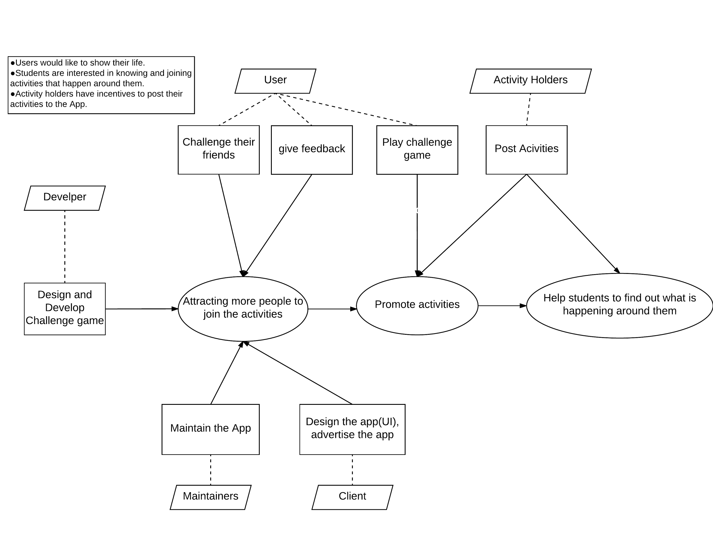
:.: Benefit Chain Diagram
11
Notes:
Assumption should be deleted some

Slide 12
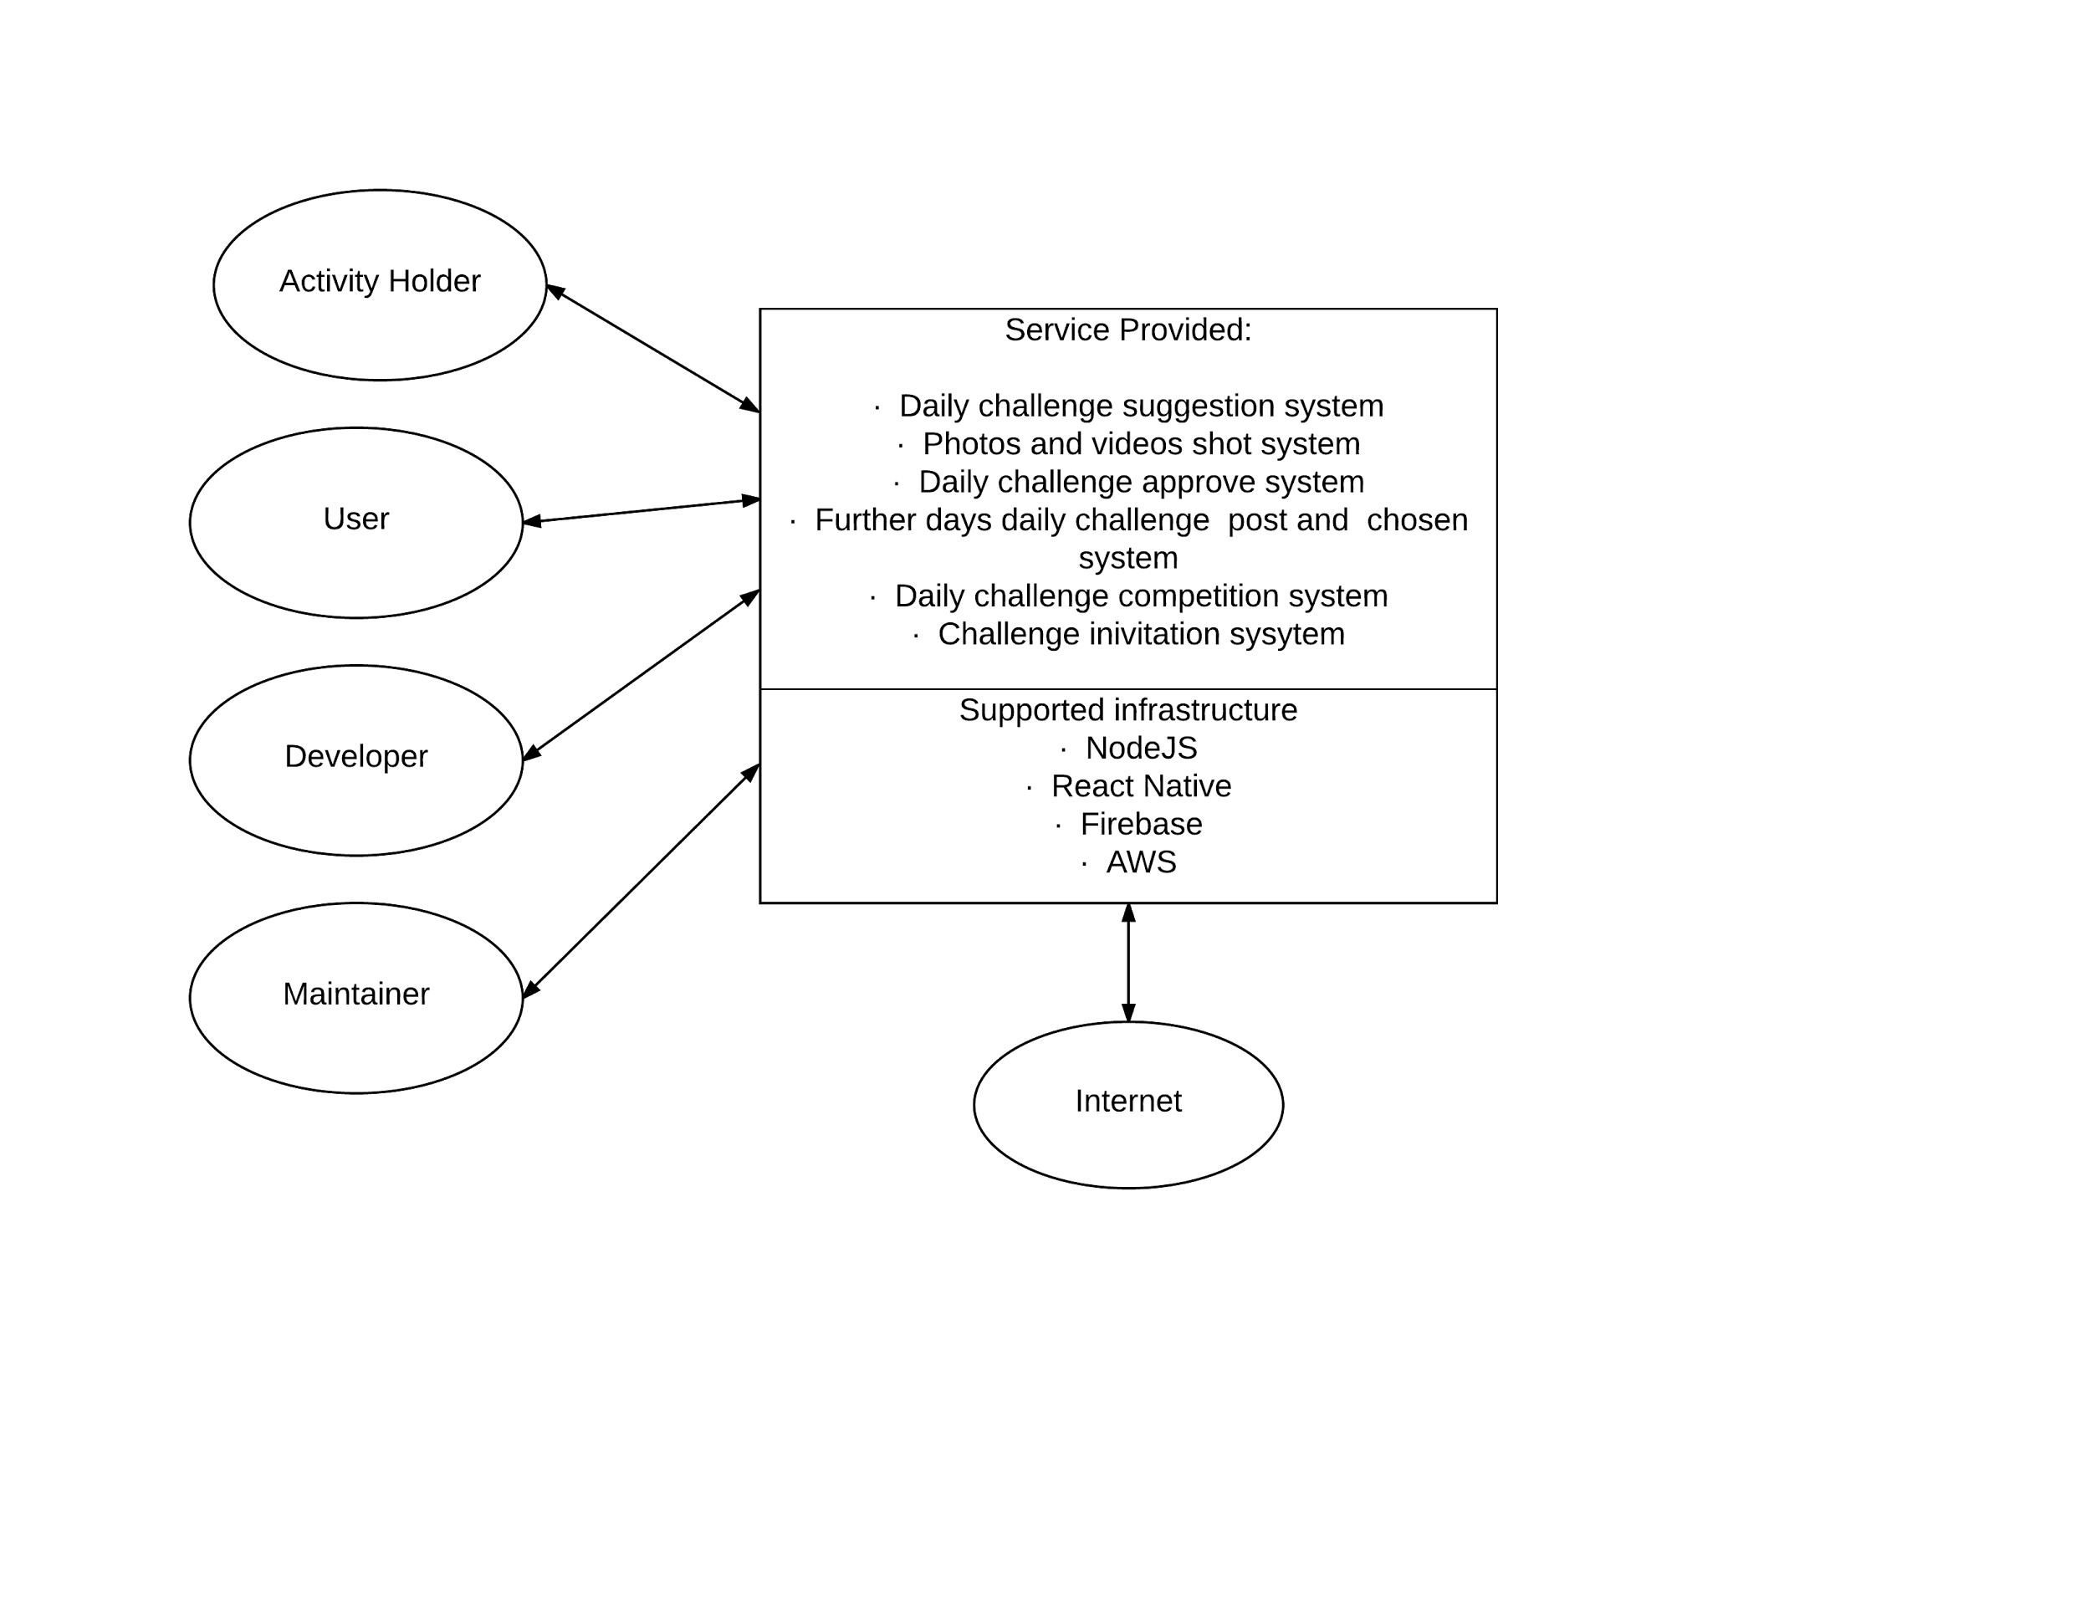
:.: Boundary
12

Slide 13
:.: Core Capabilities
13
Capability Goals | Priority Level
OC-1 Challenge Photos and Videos Post: The user can post challenge photos and videos on communities | MUST HAVE
OC-2 Challenge Complete Competition: The user can choose one friend to compete the time of finishing daily challenge | MUST HAVE
OC-3 Challenge Game Suggestion: The user can send their feedback and challenge ideas to client | MUST HAVE
OC-4 Further 5 Days Daily Challenge Post: The system will post further 5 days daily challenge. | MUST HAVE
OC-5 View, Approve or Decline Challenge: The users are capable of viewing, approve or decline their friends challenge post. | MUST HAVE
OC-6 Challenge Game Pop Screen: The user will touch the pop screen to get all daily challenge information | MUST HAVE
OC-7 Offline & Online Notification: The user will get notification from populic. | MUST HAVE
OC-8 Competition Reward: The user will get reward points from challenge competition | MUST HAVE

Slide 14
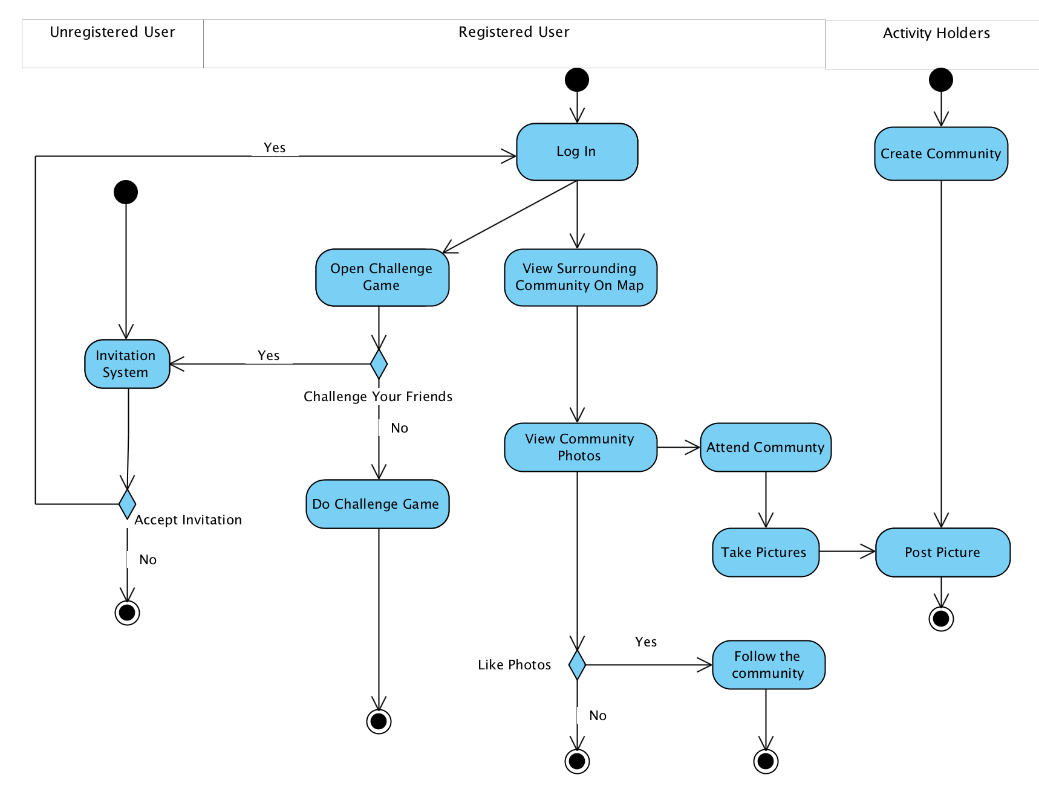
:.: Business Workflow
14

Slide 15
:.: Goals & Constraints
15
OG-1: Enlarge user’s happiness. OG-2: Raise interactions between different users. OG-3: Increase the amount of active users in Populic
CO-1: iOS as an Operating Systems: The new system should work on iOS CO-2: React Native as a Development Language: React Native will be used as a development language. CO-3: AWS as an Operating System: the available back-end server is AWS CO-4: Paid Database System: the paid database system is Firebase.

Slide 16
16
:.: Win Win Agreement

Slide 17
17
:.: Challenge Topic
Win Condition | Description
WC_4531 | As a user, I can view the details of daily challenge topic with its detail description.
WC_4595 | As a user, I can have a look of upcoming challenge topics so that I would have capability to prepare them in advance.
WC_4535 | As a user, I can give some challenge topic suggestions inside the application.

Slide 18
18
:.: Challenge Competition
Win Condition | Description
WC_4532 | As a user, I can send challenge requests to my friends via contact list and text messages.
WC_4596 | As a user, I can select a competitor from my challenger list and compete with him/her in challenge page.
WC_4533 | As a competitor, I can see the remaining time to finish the challenge.
WC_4597 | As a competitor, I can view my opponent posts from challenge page.
WC_4598 | As a competitor, I can verify (decline/accept) opponent post so that the system would assign the corresponding score to him/her.
WC_4601 | As a competitor, I can get the corresponding points based on my performance.
WC_4594 | As a user, I can purchase some goods in the embedded online shop with my points gained from competitions.

Slide 19
19
:.: Notification
Win Condition | Description
WC_4534 | As a user, I can receive a text message when one of my friends challenges me in Populic.
WC_4599 | As a user, I can receive a notification from Populic when I was picked as a competitor so that I am able to do the challenge task immediately.
WC_4536 | As a competitor, I can be informed by the app when my competitor finished the challenge so that I can verify it soon.
WC_4600 | As a competitor, I can be remained when I nearly run out of time.

Slide 20
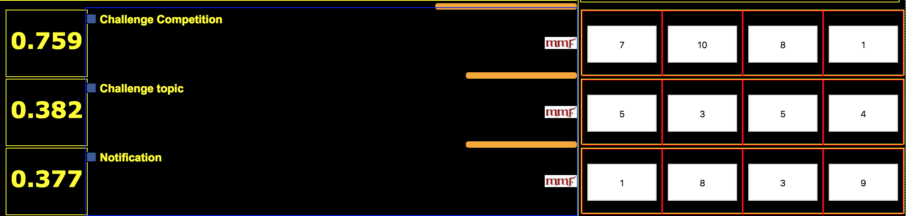
20
:.: Prioritization Score
Four benefits:
Enlarge user’s happiness. (42)
Raise interactions between different users. (72)
Increase the amount of active users in Populic. (87)
Inform students what is going on around the campus. (27)

Slide 21
21
:.: Prototype/Product Demo

Slide 22
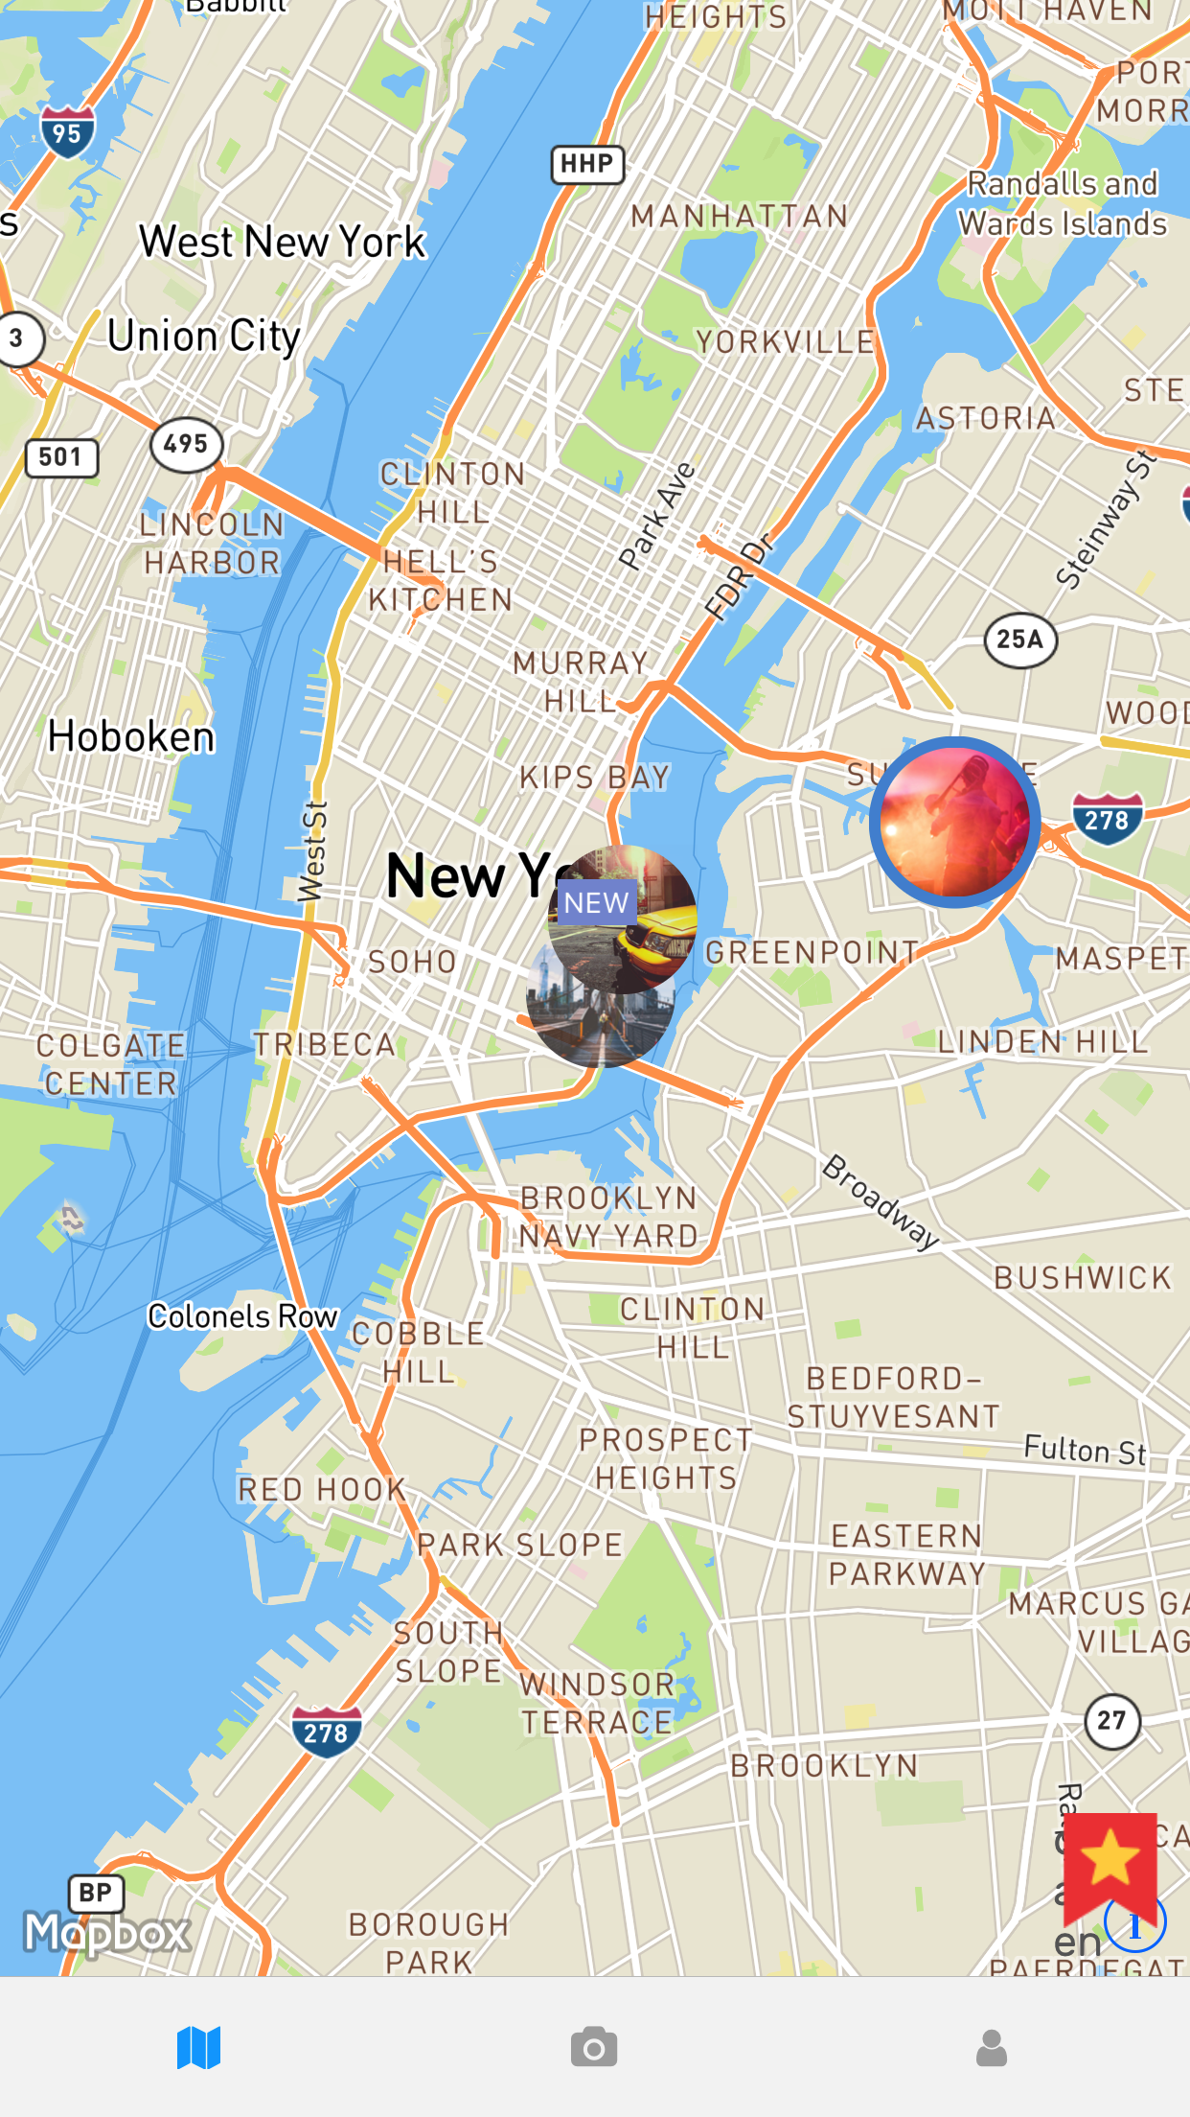
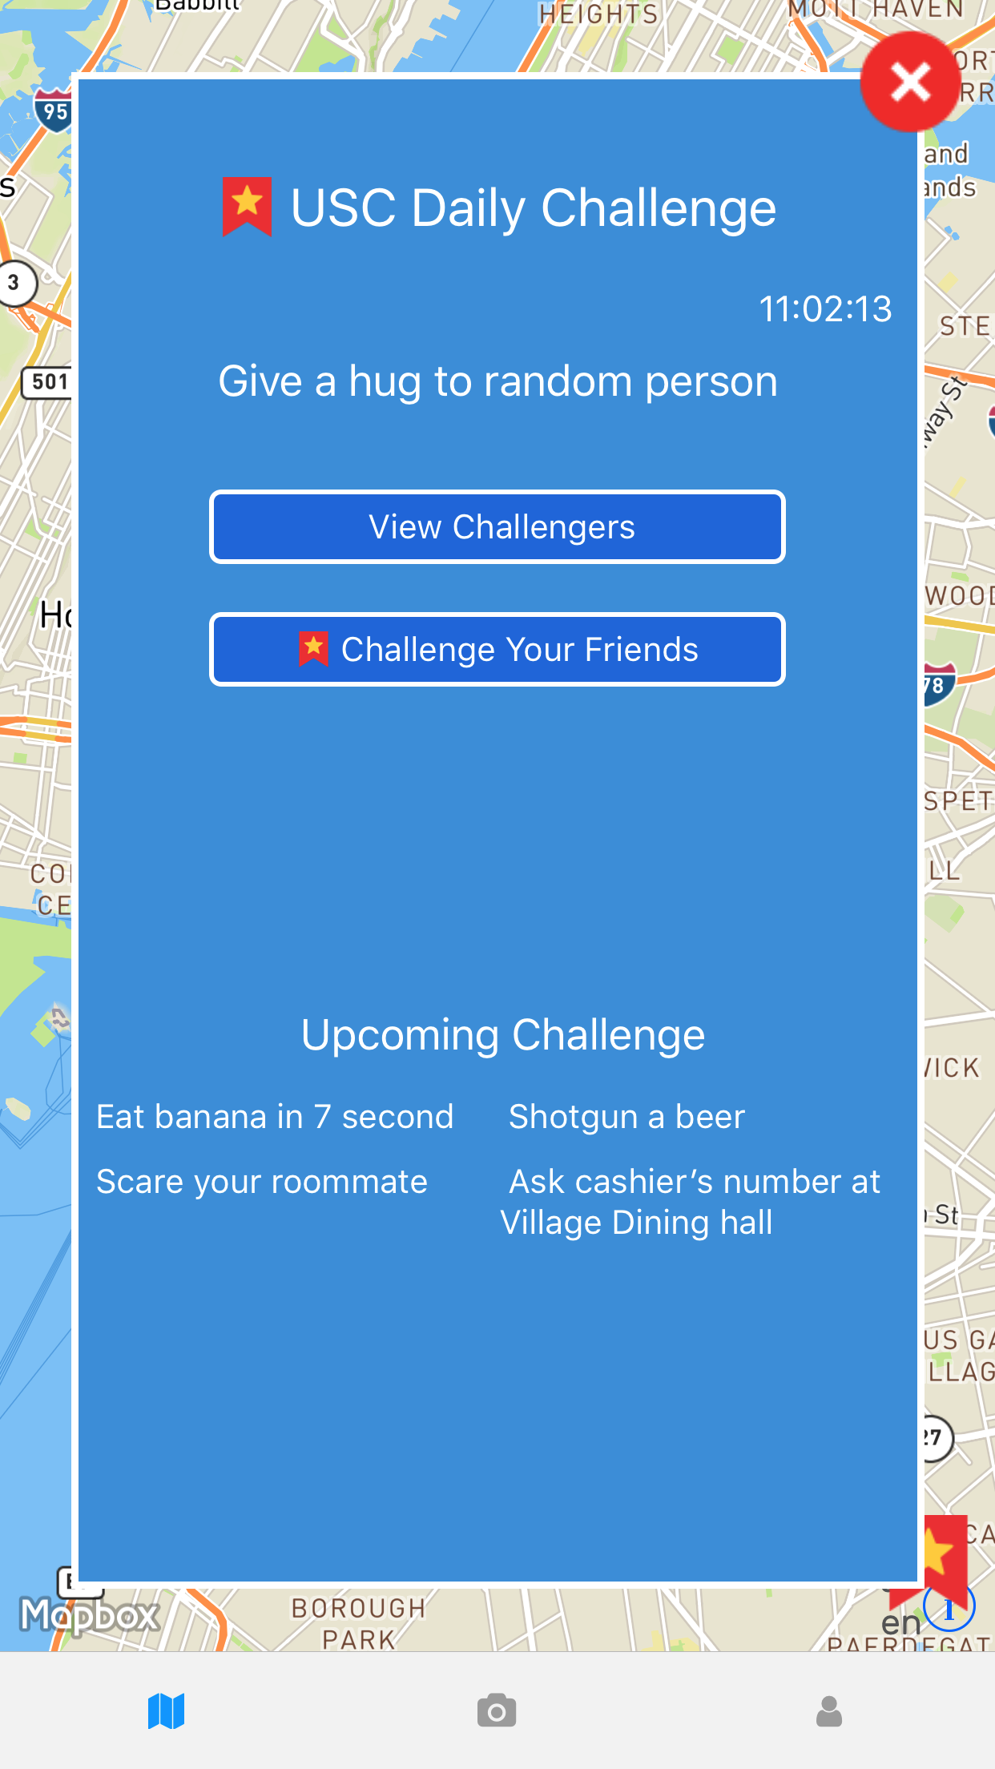
:.: Challenge Page
22
OC-6 Challenge Game Pop Screen:
The user will touch the pop screen to get all daily challenge information

Slide 23
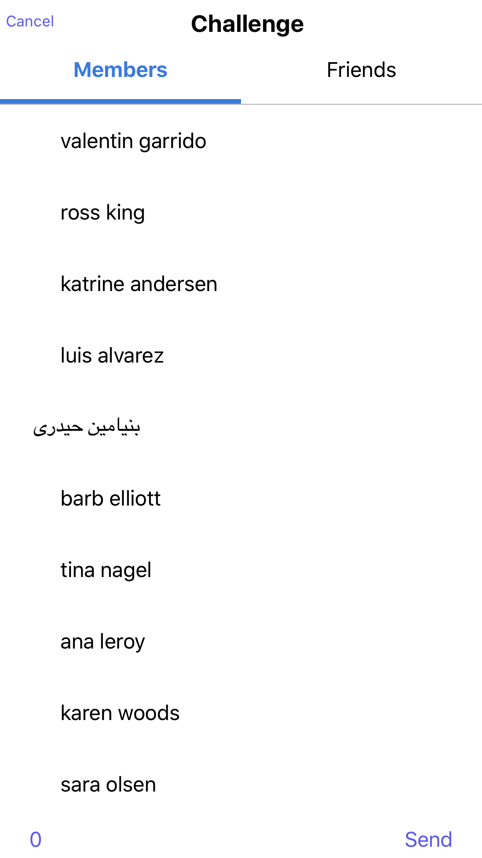
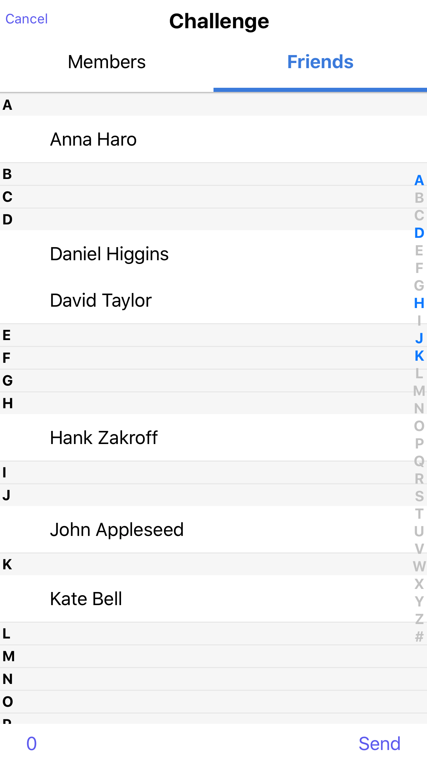
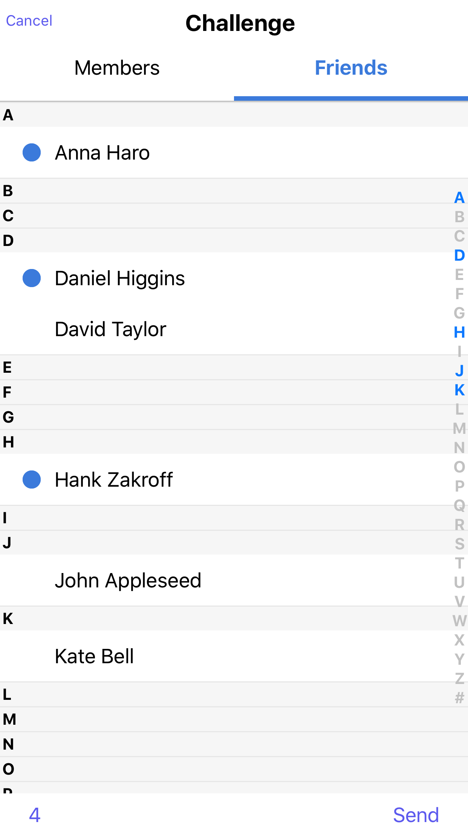
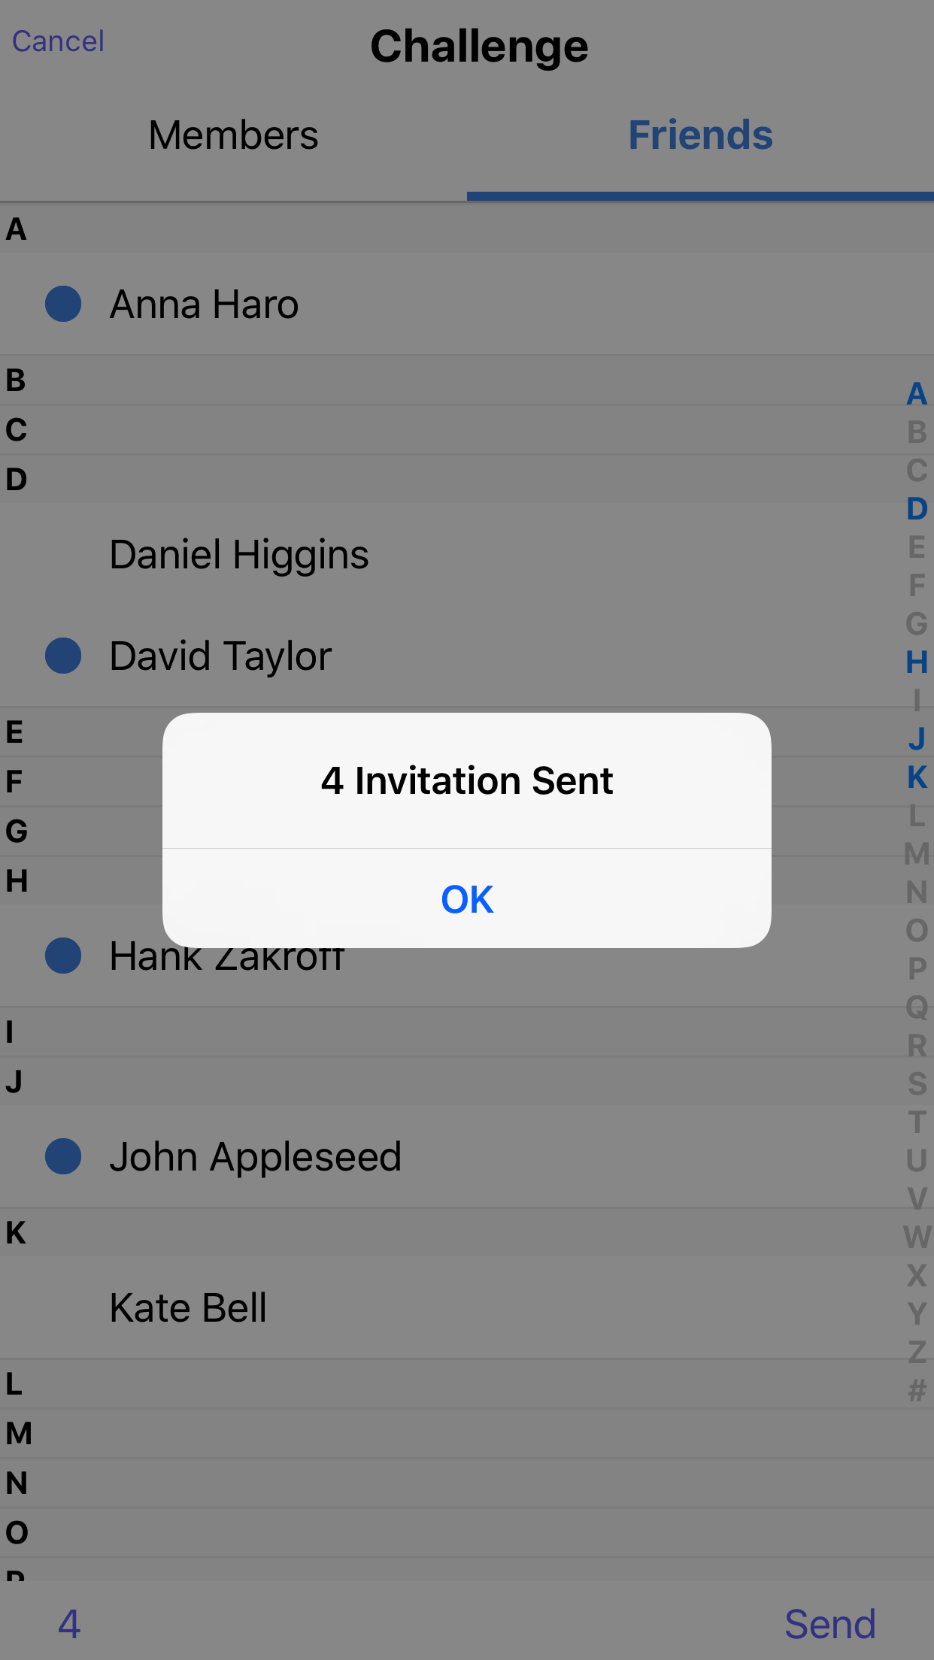
:.: Challenge Your Friends
23
OC-2 Challenge Complete Competition:
The user can choose one friend to compete the time of finishing daily challenge

Slide 24
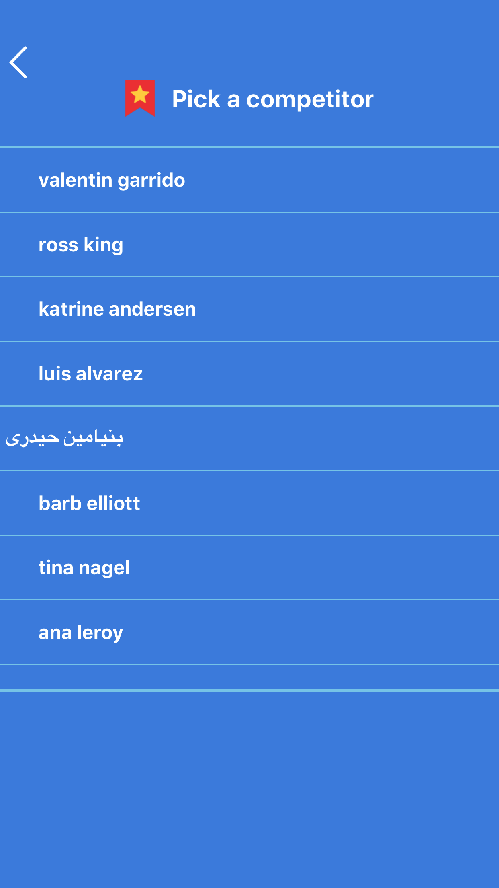
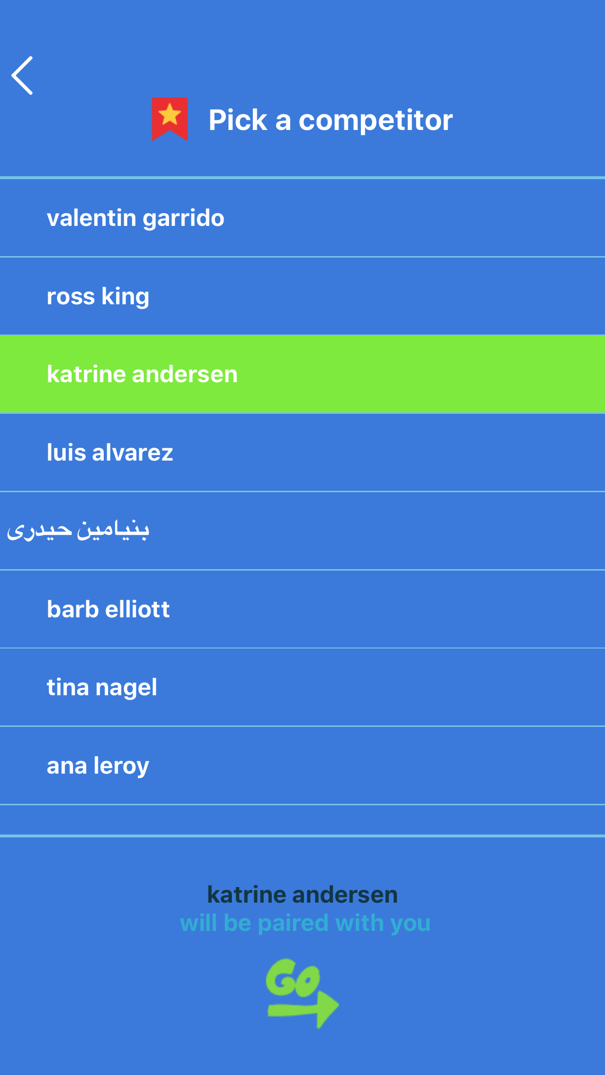
:.: Pick A Competitor
24
OC-2 Challenge Complete Competition:
The user can choose one friend to compete the time of finishing daily challenge

Slide 25
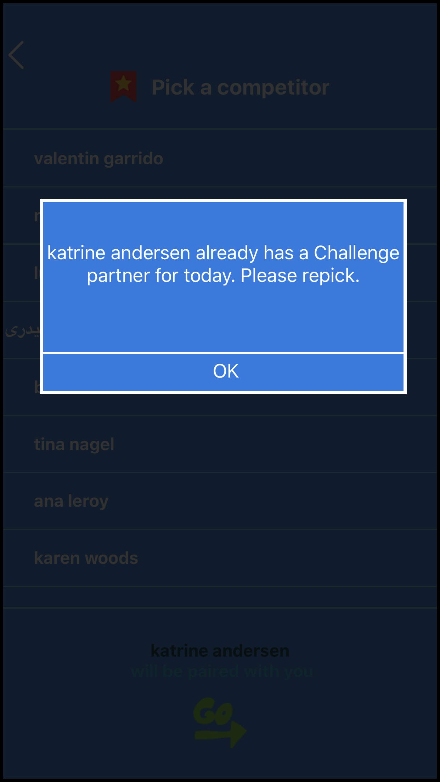
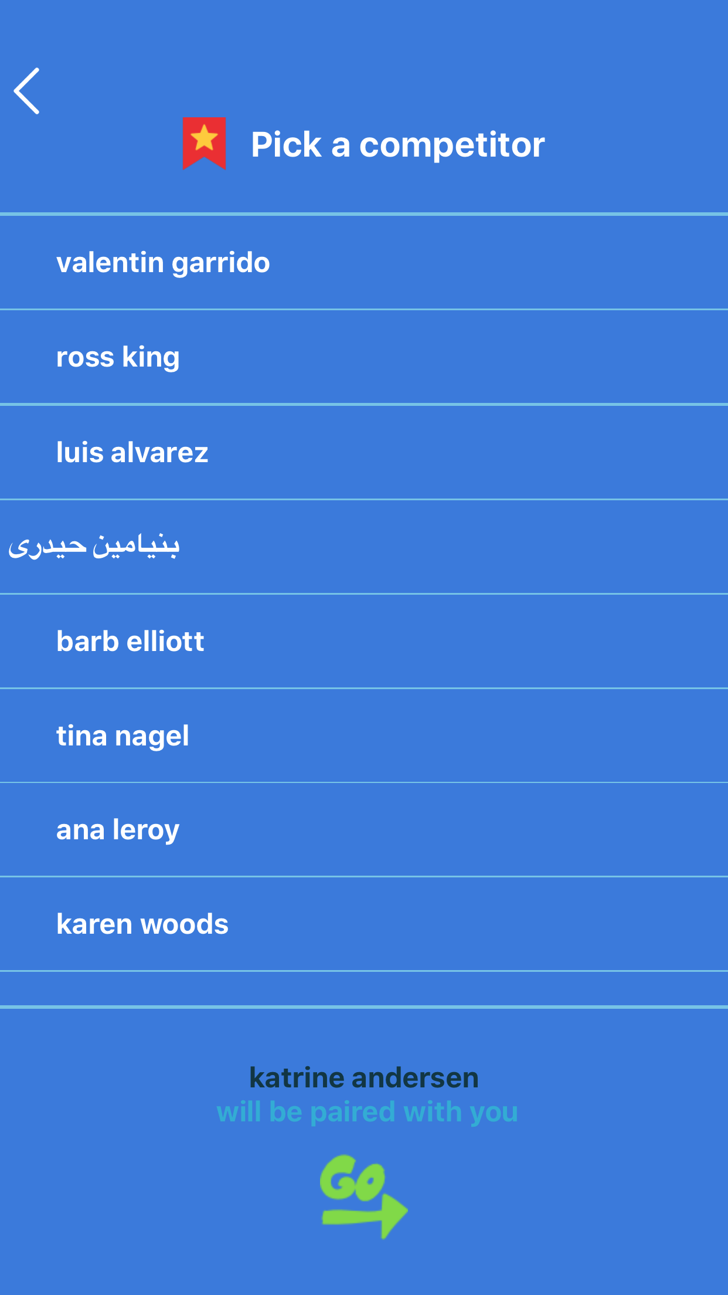
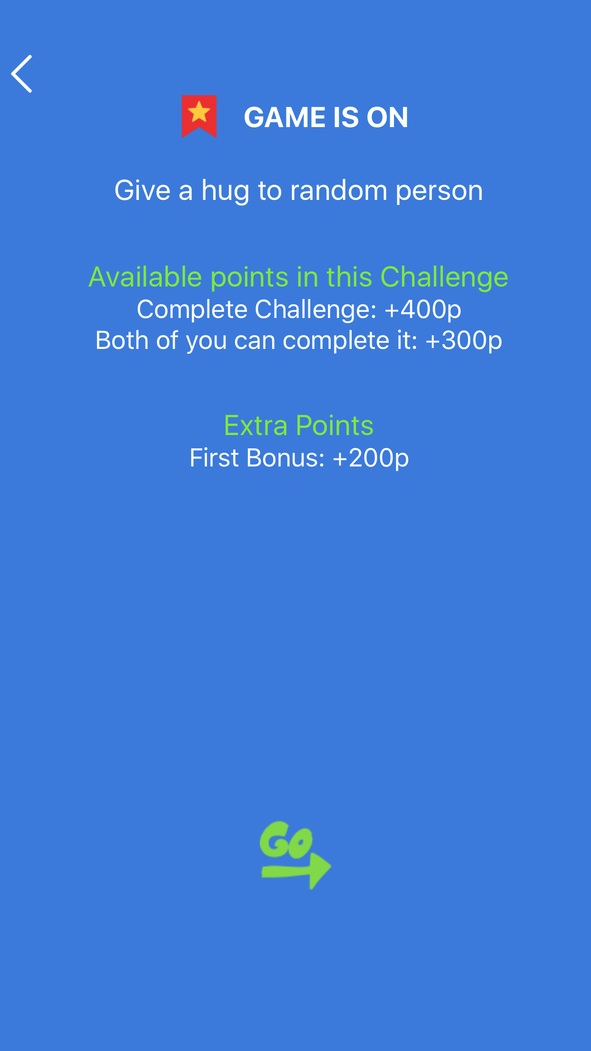
:.: Pick A Competitor
25
Repick
Success
Fail

Slide 26
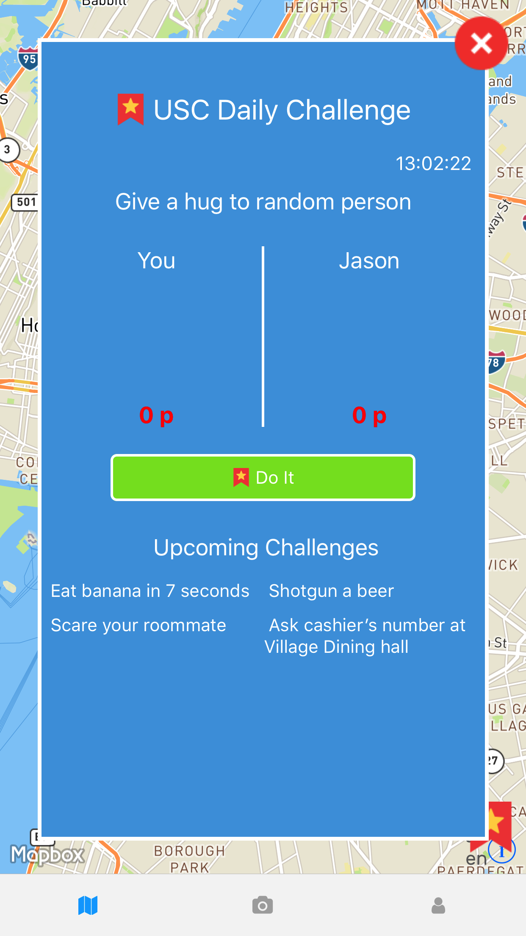
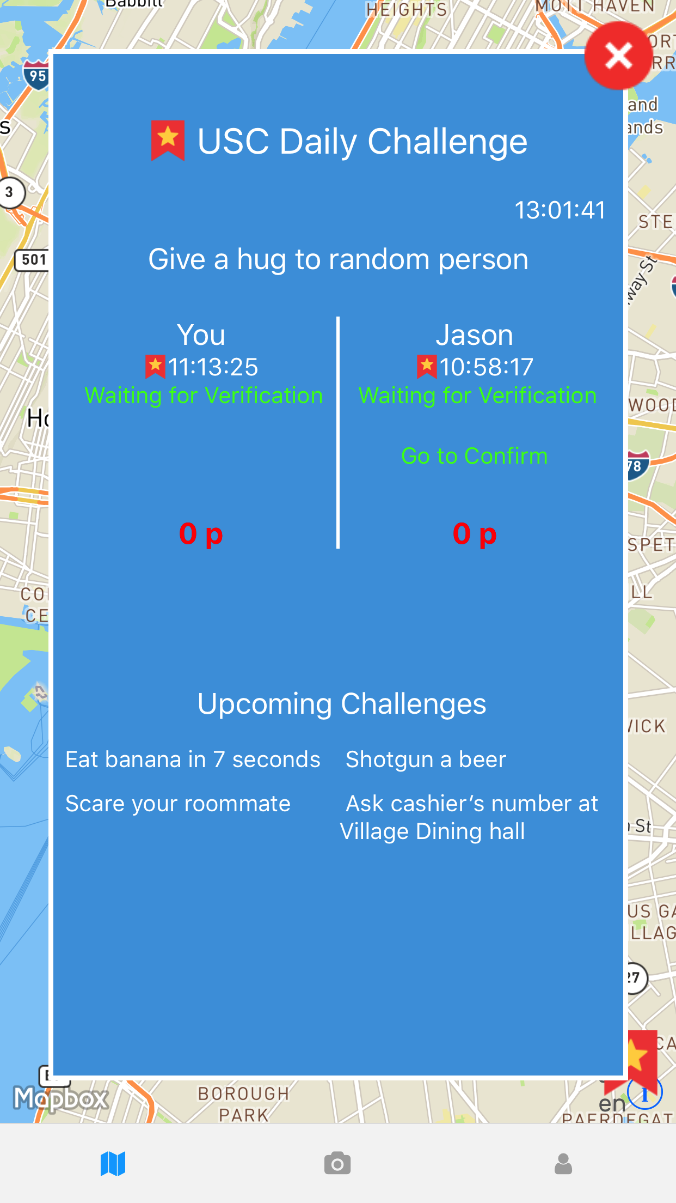
:.: Game is On
26
OC-6 Challenge Game Pop Screen:
The user will touch the pop screen to get all daily challenge information
Initial GameOn Page
Waiting for Verification

Slide 27
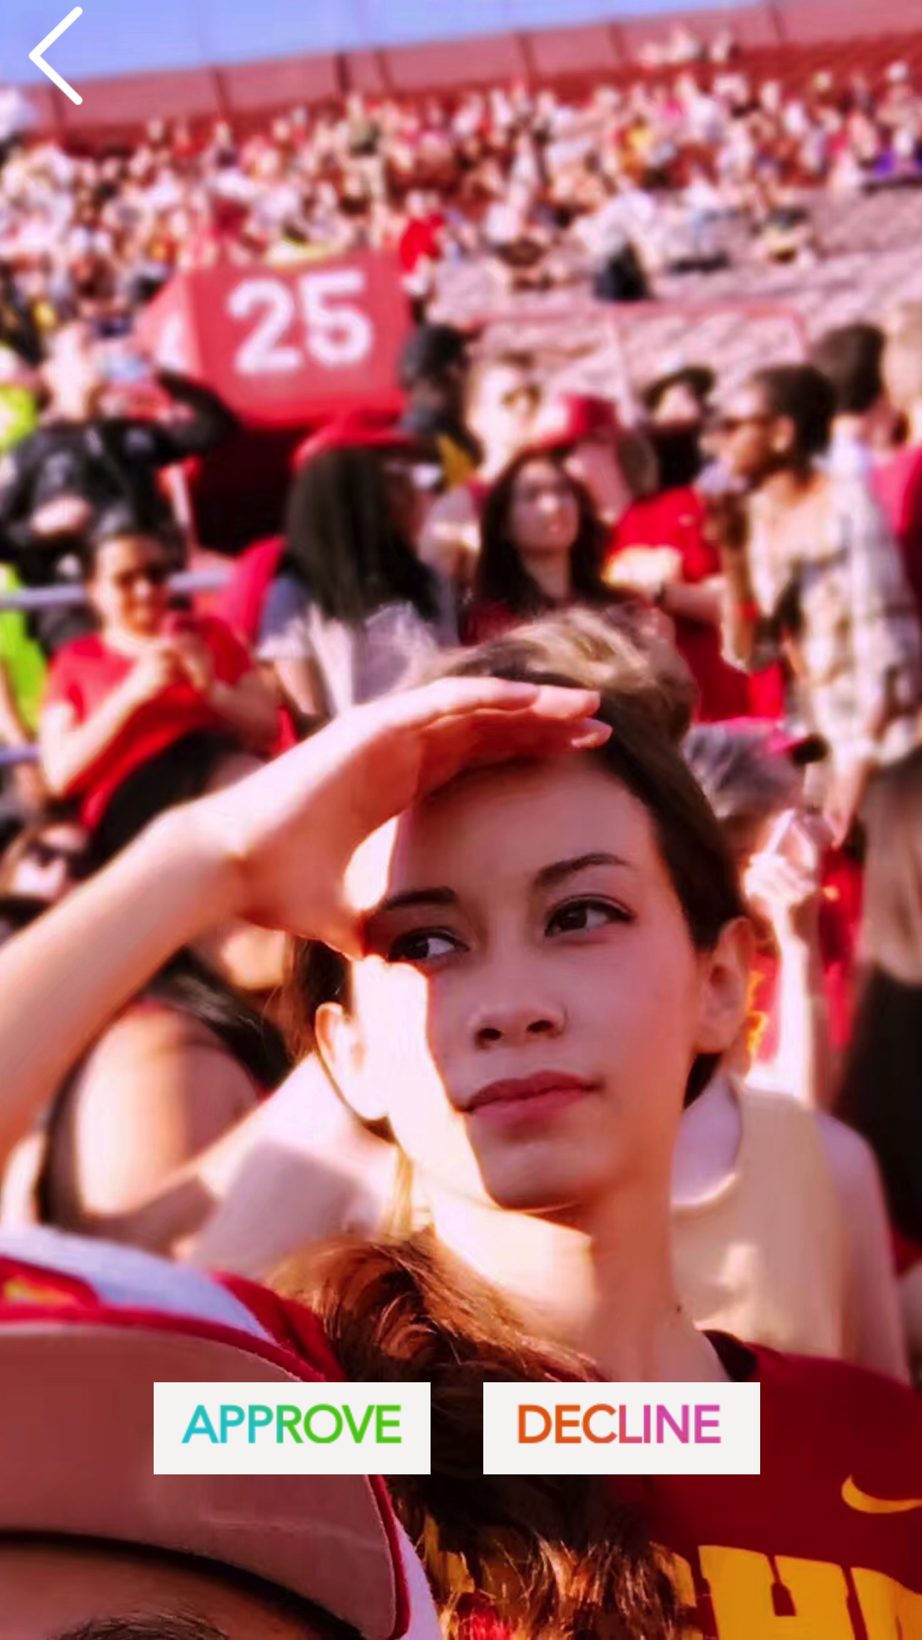


:.: Game is On -- Confirm/Decline
27
OC-5 View, Approve or Decline Challenge:
The users are capable of viewing, approve or decline their friends challenge post.
Approved
Declined

Slide 28
28
:.: Architecture

Slide 29
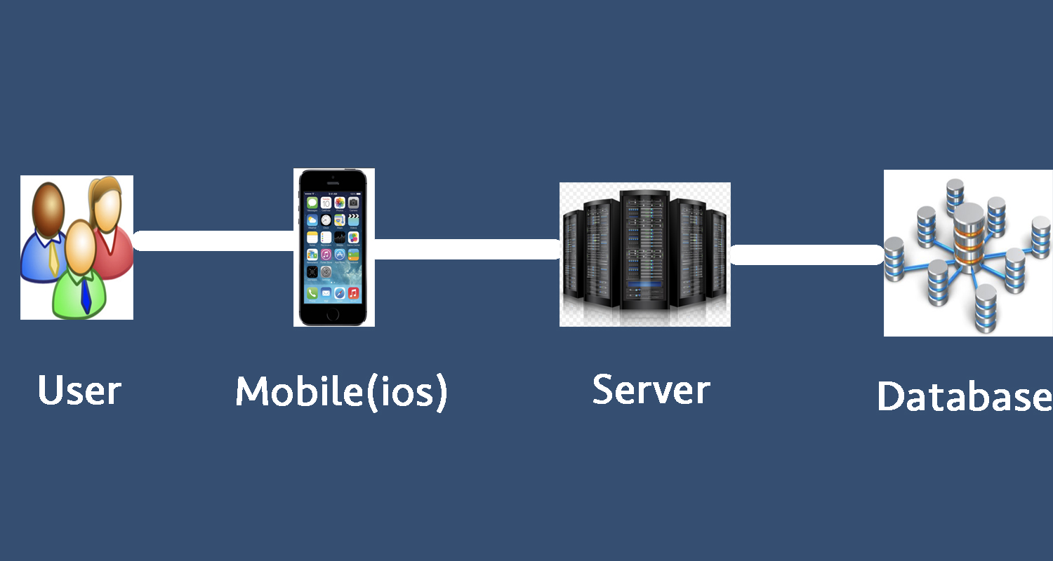
:.: Top level physical
29

Slide 30
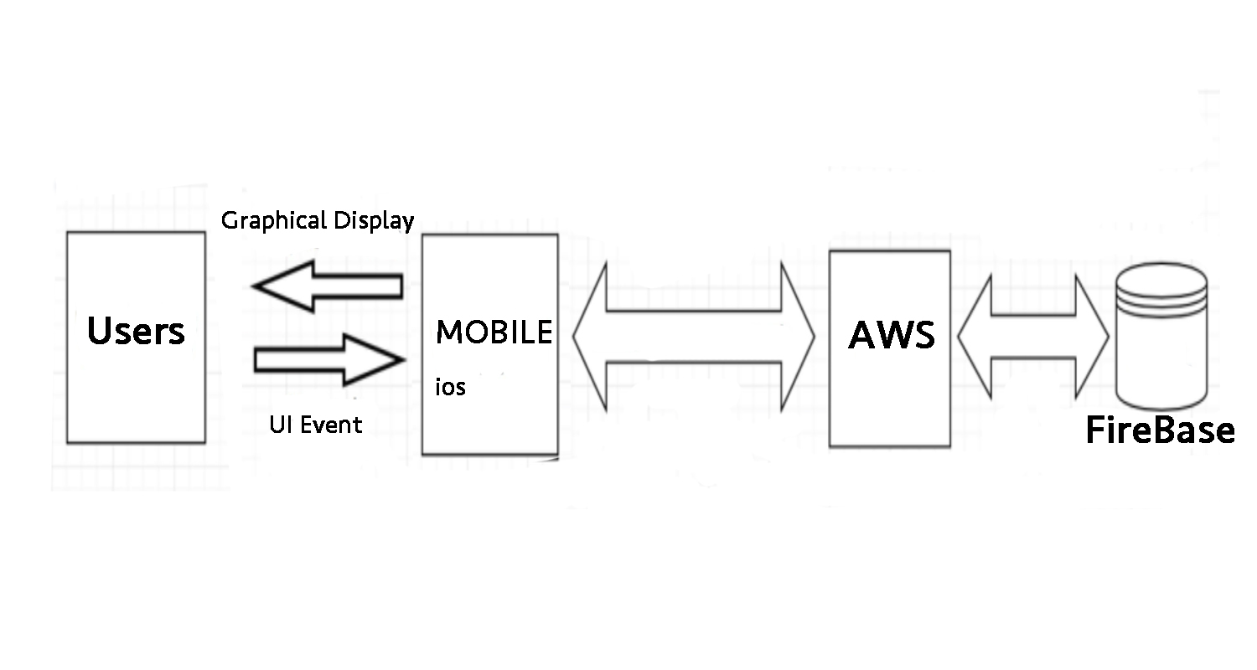
:.: Top level logical
30

Slide 31
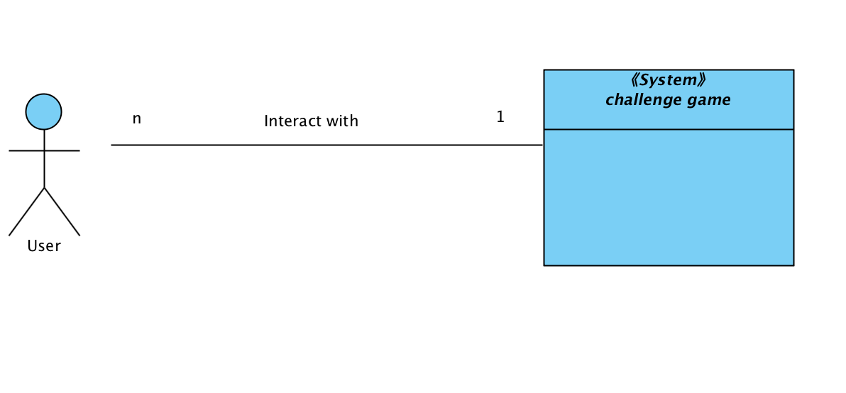
:.: System Context
31

Slide 32
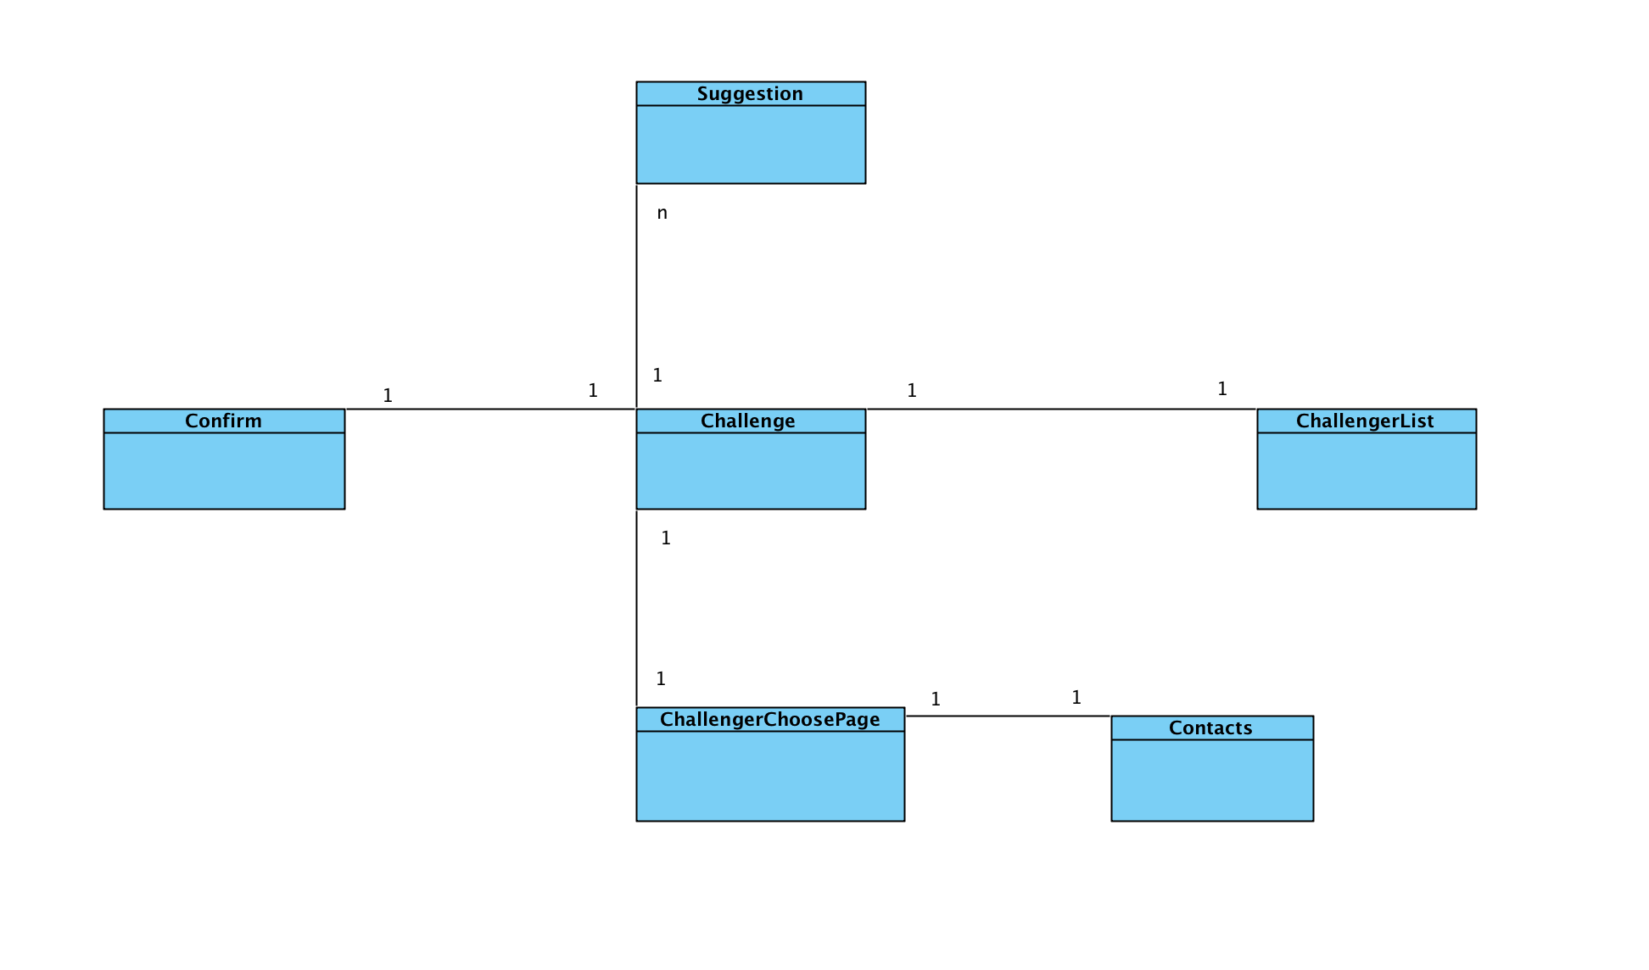
:.: Artifacts and information diagram
32

Slide 33
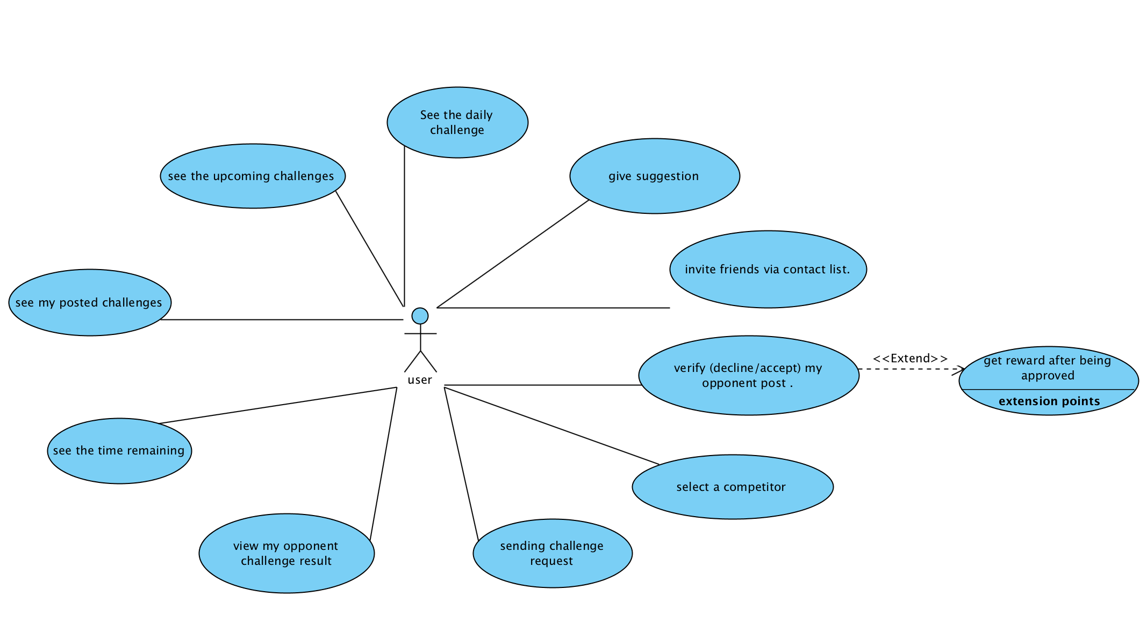
:.: Use Case Diagram
33

Slide 34
34
:.: Challenge Competition
Use case | Description
UC - 1seeing daily challenge | seeing the daily challenge current on the challenge page.
UC - 2seeing upcoming challenge | seeing the upcoming challenge of next five days on the challenge page.
UC - 3 seeing the time remaining | seeing the time remaining of the challenge of current daily challenge.
UC - 4 seeing own result | seeing own post challenge result after users have post their result.
UC - 5 seeing opponent result | seeing opponent challenge result after opponent have post their result.
UC - 6 send challenge request | send challenge request to the friend who the user want to challenge.
UC - 7 select a competitor | select a competitor from the challenger list to compete with for today’s challlege
UC - 8 verify competitor result | verify competitor challenger result after the opponent have posted the result.
UC - 9 invite friend | invite friend from contact list who have not download this app.
UC - 10 give suggestion | give suggestion of new challenge idea and submit the idea.
UC - 11 get reward | get reward after being approved by user’s opponent.

Slide 35
35
:.: Life Cycle Plan

Slide 36
:.: Life Cycle Plan
36
Purpose
Plan each phase of project
Monitor and manage resources, track deliverables and risks.
Development Strategy
NDI/NCS Intensive Process
Assumptions
Project will be completed within one semester(12 weeks)
Currently in Foundation
Notes:
: All the capabilities (functions) of our system are delivered by COTS/ services like Squarespace, MailChimp and Stripe.
we also need the API provided by Share APP to retrieve the data we need and NCS as services to host our website.
Assume
based upon the life cycle theory

Slide 37
37
:.:Team member role
Name | Role
Chengyu Shen | Project Manager, Operational Concept Enginner
Shiji Zhou | Prototyper, Software Architect
Yufei Hong | Feasibility Analyst, Project Manager
Guanghe Cao | Software Architect, Life Cycle Planner
Yang Wei | Operational Concept Engineer, Prototyper
Lin Xia | Life Cycle Planner, Feasibility Analyst
William Goishi | IIV & V, Quality Focal Point, Tester
Notes:
Document and development modul part
Take part in develop , list the other job they focus on
people with the primary responsibility for main resposible person

Slide 38
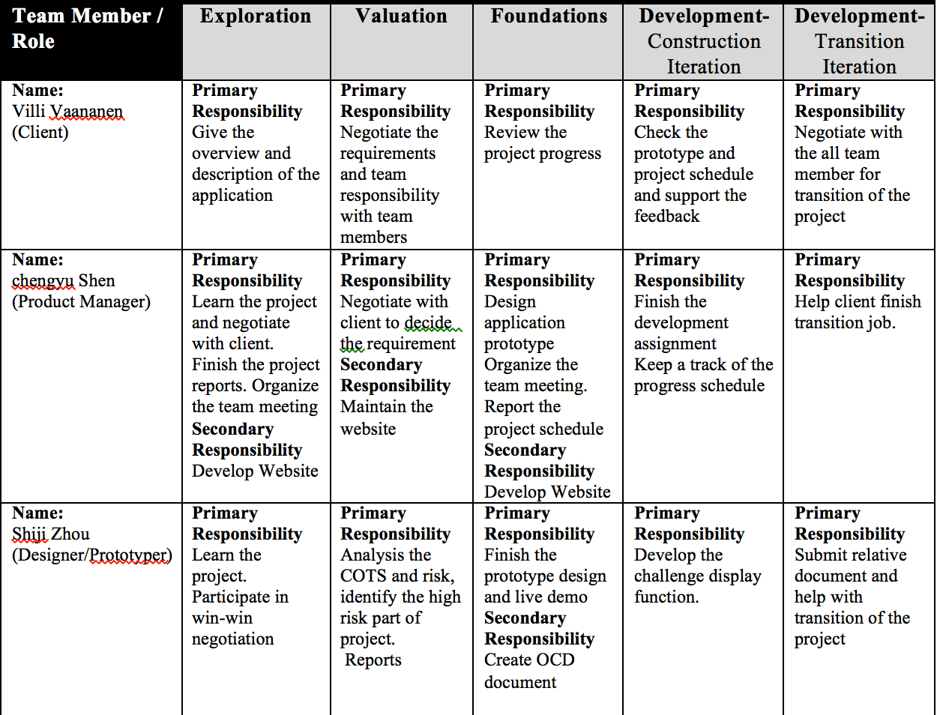
38
:.: Stakeholder responsibilities
Notes:
Document and development modul part
Take part in develop , list the other job they focus on
THE TEAM member’s job in this table is a little overlap with preive

Slide 39
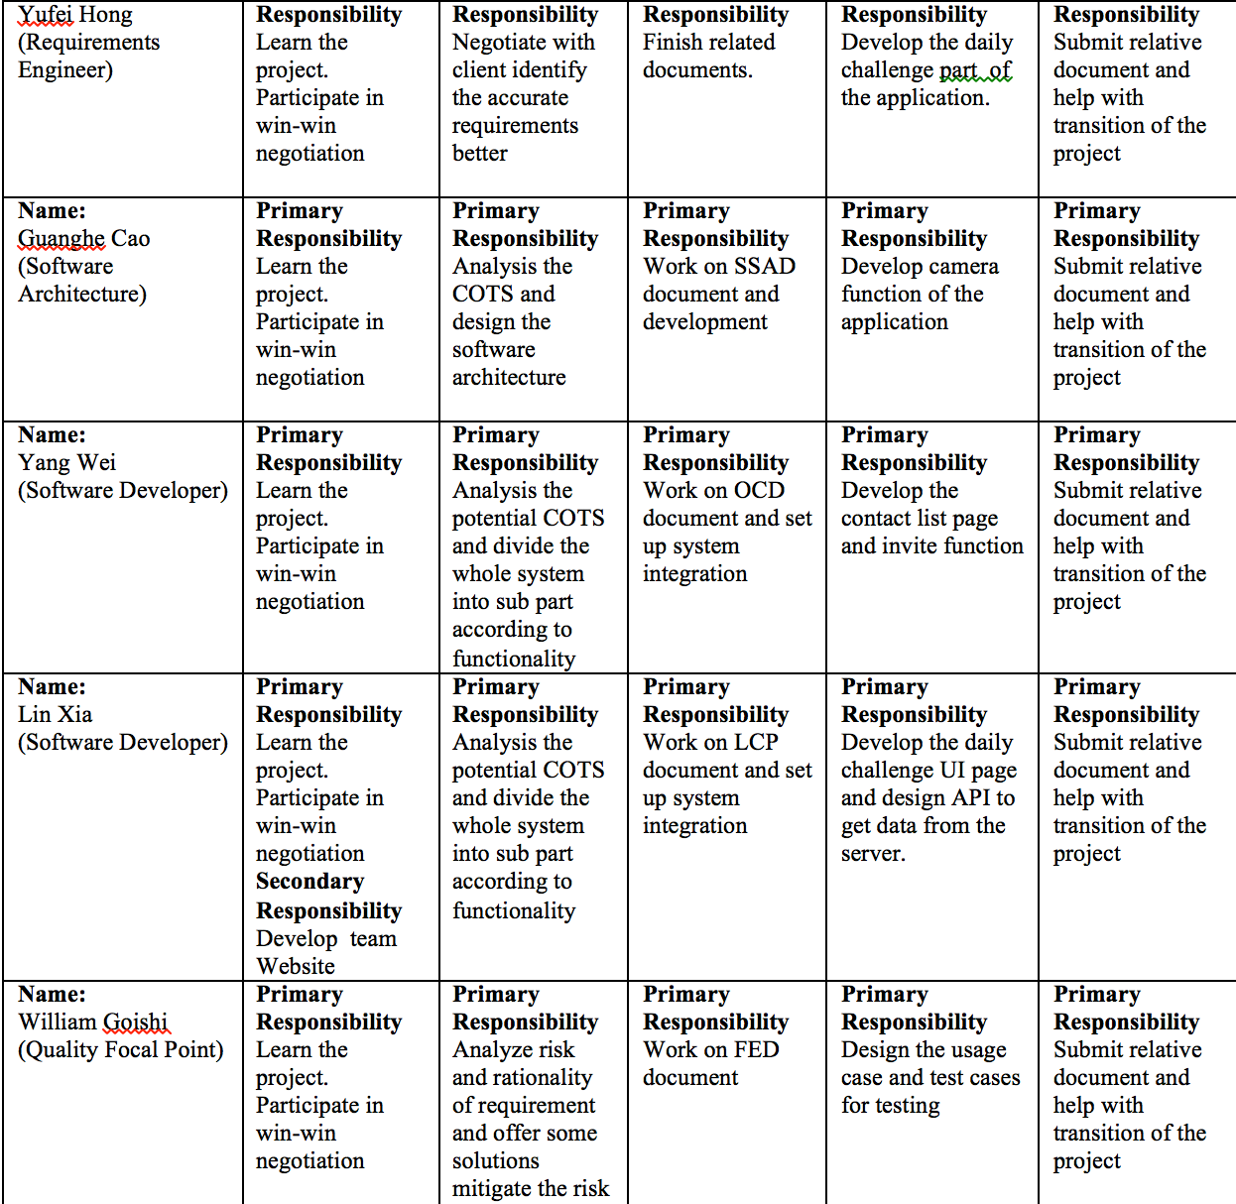
39
:.: Stakeholder responsibilities
Notes:
Document and development modul part
Take part in develop , list the other job they focus on

Slide 40
:.: Exploration phase
40
Duration: 09/12/2017-09/22/2017
Activities
Identify initial scope of the product
Understand the application architecture and product plan
Decide the team roles
Deliverables: Valuation Report and Team Website, Client Interaction Report, Project Plan, Progress Report.
Milestone: Valuation Commitment Review
Notes:
through the analysis of previous version.
through client meetings and win-win negotiation
Based on capability of each member

Slide 41
41
:.: Valuation phase
Duration: 09/22/2017-10/2/2017
Activities:
Plan the final function and requirement.
Seek the potential COTS
Identify all the risks and rank them.
Attempt to implement the high risk prototype
Deliverables: Win-Condition Report, High Risk Prototype, Project Plan, Progress Report.
Milestone: Foundation Commitment Review
Notes:
Negotiate with client to
which could be used in the later development phase according to the determined requirement.
and discus the method to mitigate those risks.

Slide 42
42
:.: Foundation phase
Duration: 10/02/2017- 10/18/2017
Activities:
Finish the whole risks function prototype.
Mitigate the risks.
Finish the architecture.
Deliverables: Development Commitment Package, Risk and Defect Report, Project Plan, Progress Report.
Milestone: Development Commitment Review
Notes:
According to determined COTS and requirement,
Discuss with client and improve the prototype.
Oct

Slide 43
43
:.: Development phase
Construction Iteration
Duration: 10/19/2017- 11/10/2017
Activities:
Finish front-end and back-end part of the project
Peer Reviews for features and code quality
Client feedback on various functionalities
Deliverables: Core Capability Drive-Through Report, Risk and Defect Report, Progress Report, Technical Debt Report
Milestone: Transition Readiness Review, Core Capability Drive-Through
Notes:
According to determined COTS and requirement,
Discuss with client and improve the prototype.

Slide 44
44
:.: Development phase
Transition Iteration
Duration: 11/11/2017- 12/09/2017
Activities:
transition of the project
Test the whole functionalities
train client and their developer
Deliverables: Progress Report, Technical Debt Report
Milestone: Core Capability Drive-Through, Transition Readiness Review
Notes:
According to determined COTS and requirement,
Discuss with client and improve the prototype.
to maintain the system if needed.

Slide 45
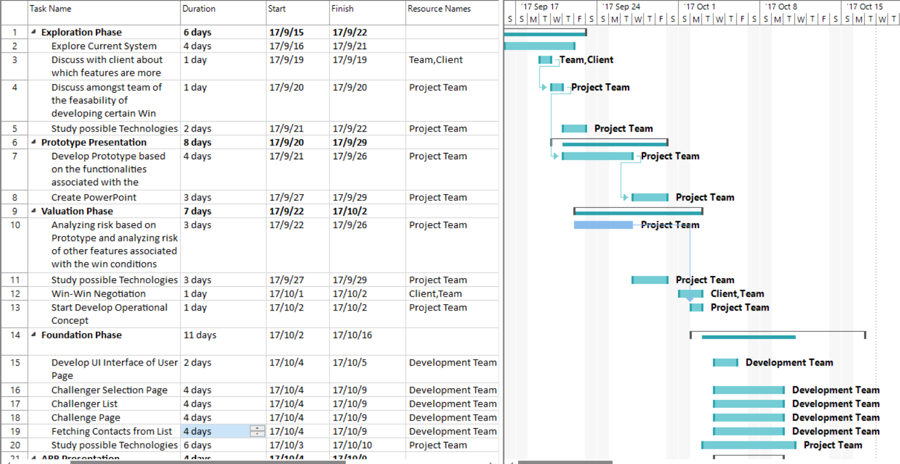
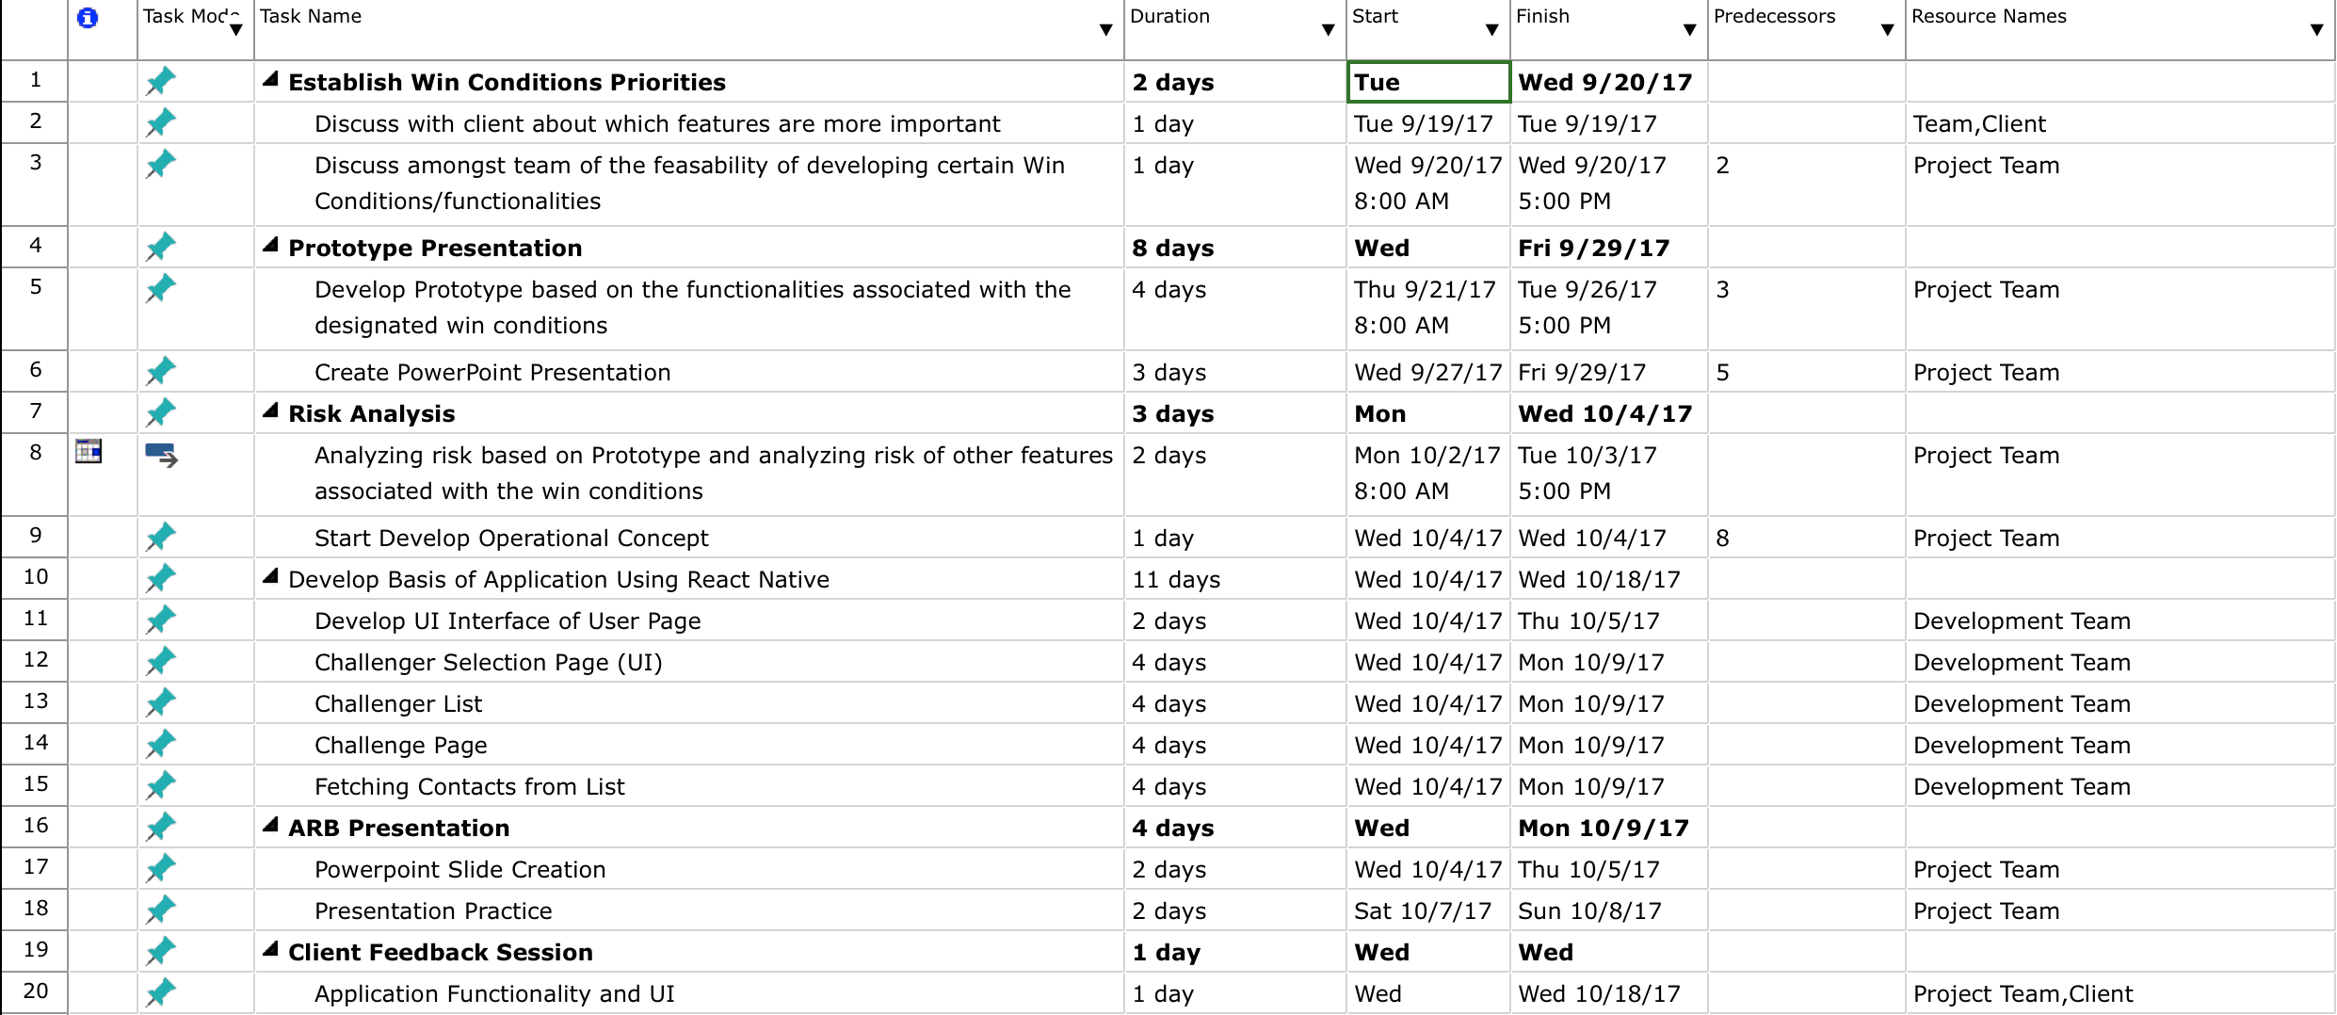
45
:.: Project Plan

Slide 46
46
:.: Scale Factors
Scale Driver | Value | Rationale
Precedentedness (PREC) | LOW | All team members were new to React Native, Only one has experience with the node.js.
Flexibility (FLEX) | HIGH | The client is flexible about the requirements and willing to give us the suggestion regarding the UI and UX.
Risk Resolutions (RESL) | NOM | Prototyp high risk functionality Buy information from client.
Team Cohesion (TEAM) | HIGH | We have weekly team meetings. That help each team members understand the project schedule. Peer review ensure we don’t have much technical debt.
Process Maturity (PMAT) | NOM | Team follow the ICSM guidelines which is consistent with CMM.

Slide 47
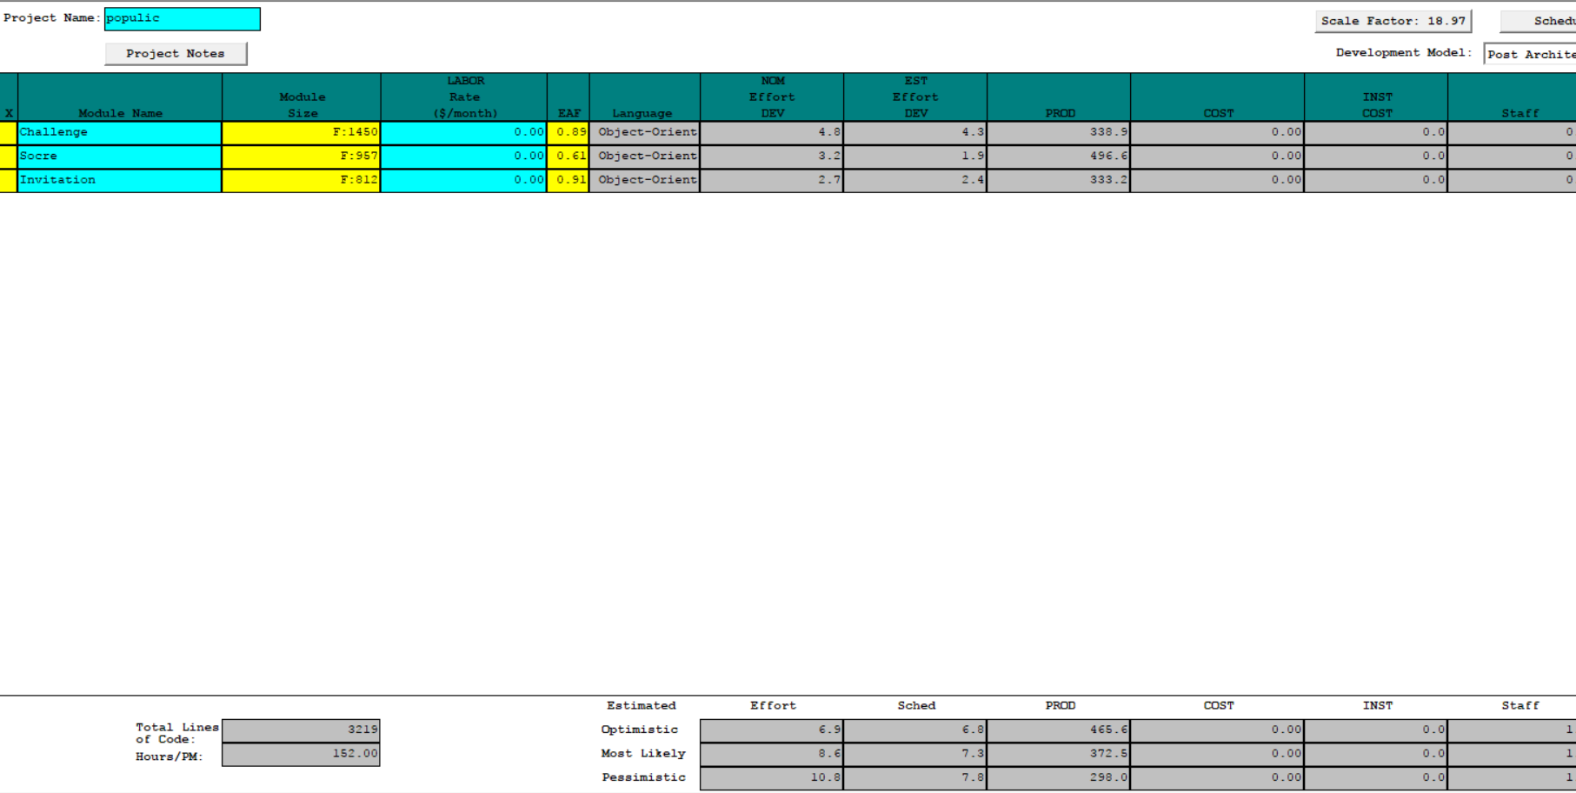
47
:.: COCOMO II Estimate

Slide 48
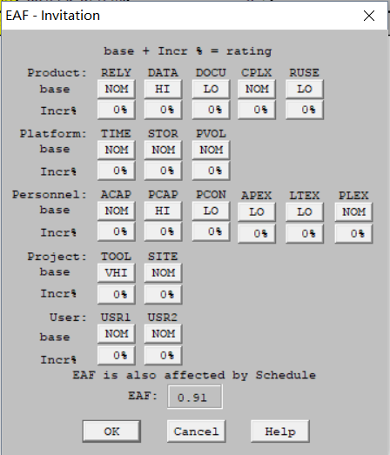
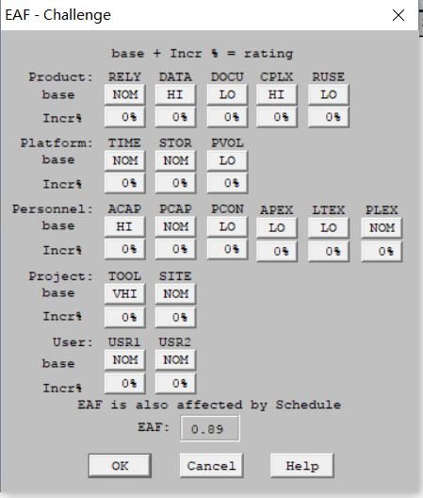
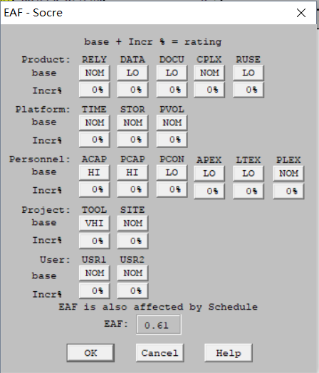
47
:.: COCOMO II Estimate

Slide 49
48
:.: Project Estimation
Number of SLOC: 3,219
Effort needed (Most Likely): 8.6 Person-Month
Each Member Works: 15 hrs/week for 12 weeks
Time Spent by Members:
Monthly Efforts: 15 hrs/week × 7 members × 4 weeks = 420 hrs/month
Total Efforts: 15 hrs/week x 7 members x 12 weeks = 1,260 total hours
Time Needed:
Monthly Efforts: (10.3 person-month x 152 hrs/person-month) ÷ 560 = 3.11 months
Total Efforts: (10.3 person-month × 152 hrs/person-month) = 1,307.2 total hours
Result: According to the above estimation, the project will take 3.1 months to complete. The team has 12 weeks which is within the estimated time to complete the project
Notes:
Is it possible: Yes, according to the above estimation, the project will take 3.11 months to complete. The team has 12 weeks which is within the estimated time to complete the project.

Slide 50
49
:.: Feasibility Evidence

Slide 51
:.: Major Risks
50
Risk Description | Risk Mitigation | Risk Exposure
Inaccurate understanding of software requirements: The client asked that user can challenge his/her app friends, however there is no friend system in the app and user can only join in community and follow other people and currently, even the client cannot give a specific explain about what is “friend”. Also, there is no friend list in the app and it is impossible for user to challenge friends via friend list. | Verify win condition with clients, currently, we assume that if people followed each other, then, they will be considered as friends. Incremental development the highest priority features and functions first, negotiate with the client to see if we should add a friend system or use the above concept to define friend. | 5 | 6 | 30

Slide 52
:.: Major Risks
50
Risk Description | Risk Mitigation | Risk Exposure
Requirement Changes: For the score system, the initial idea is to give a rank list to show people who has the highest score on it. However, the later requirement changed from the rank list to user can use the score to buy some fancy stickers from inner app. For now, client changes his mind again and there is no specific requirement for this score system and the client is still thinking and evaluating about this part. Then, the source code of this part has been changed again and again. | Follow the incremental development strategy, to develop the important part first to make sure that the main functions of the challenge game are working fine. Leaving the unsure parts away and give a suitable connector source code for it. To negotiate with the client and also give some possible choices for the unsure parts to client to think about. | 5 | 7 | 35

Slide 53
:.: Major Risks
50
Risk Description | Risk Mitigation | Risk Exposure
Personnel shortfalls: Since React-Native is a new technology for us, many team members have no experience on it. Besides these, this is a new team and we don’t know each other very well, sometimes there is a communication problem between members of diverse background. | Doing researching and self- learning for the new technology and to understand how to use the React-Native framework to build app. To schedule team meetings as more as possible and have more communications and negotiations with the members to better understand their backgrounds and skills. | 3 | 8 | 24

Slide 54
:.: Major Risks
50
Risk Description | Risk Mitigation | Risk Exposure
Software interface mismatch: During the development, the client changes the idea of UIs, fonts. colors and layout design again and again and never has a final version of the layout. | Making several prototypes of the interface layout and negotiate with client to figure out which version will have satisfied with him. And also negotiate with client to suggest him to hire people who are good at UI design instead of designing UI by himself and change it again and again later. And also, based on our knowledge, give client some suggestions about the choice of background color and font. | 6 | 7 | 42

Slide 55
:.: Business Case Analysis
51
Personnel Costs (12 weeks in total)
Exploration, Valuation and Foundation phases
Activities |  | Time Spent (Hours)
Win Win negotiation session 1 |  | 2.0
Win Win negotiation session 2 |  | 2.0
Client meeting via email, slack. |  | 5.0
Architecture review boards |  | 6.0

Slide 56
:.: Business Case Analysis
52
Personnel Costs (12 weeks in total)
Development and Operation Phases
Activities |  | Time Spent (Hours)
Development (2hrs/week * 12 * 1person) |  | 24
Project process meeting with client (1hr/2 weeks * 12 weeks) |  | 6
Total |  | 79
Maintenance Period (1 year)
Maintenance |  | 1/week
Total |  | 52

Slide 57
:.: Business Case Analysis
53
Hardware and Software Costs
Type |  | Cost |  | Rational
Mac |  | Free |  | Development OS
React-Native |  | Free |  | API dependence
Xcode/WebStorm |  | Free |  | Development tools
AWS |  | $200/month |  | Server
Firebase |  | Free |  | DBMS

Slide 58
:.: Business Case Analysis
54
Benefit Analysis
Current activities & resources used |  | %Reduce |  | Time Saved (Hours/Year)
Number of users
Increase the user base for client(currently is 50) |  | 100% |  | 50
Number of posts
Increase the number of posts fro client (currently is 50) |  | 100% |  | 50
Total |  | 100

Slide 59
:.: Architecture Feasibility
55
Level of Service Feasibility
LOS-1: The layout of challenge game should be responsive and at least support all size of iPhone |  | Product strategies: Xcode, React-Native API package
 |  | Process strategies: Set proper size based on the window size, and React-Native stylesheet will judge the size of layout
 |  | Analysis: We will use Xcode simulator to test the visibility of the challenge game to see if the challenge in different iPhone device has the same performance
LOS-2: The challenge game should be able to load data less than 2 secods |  | Product strategies: Xcode, React-Native API package
 |  | Process strategies: Instead of fetching all data in one time, only fetch the data user needed. When user jump to a specific pop up page, the page will atomically download data user currently needed but not all data of all pages. So that the load time has been decreased.
 |  | Analysis: We installed the app in our own phones, and test the loading time of all pop up pages in different Internet environment. With this new strategy, the load time for pop up page was less than 1 second.

Slide 60
:.: Architecture Feasibility
56
Capability Feasibility
Challenge Photos and Videos Post |  |  | Software/Technology used: Xcode/WebStorm, React-Native libraries.
 |  |  | Feasibility Evidence: Develop a prototype to implement challenge function
Challenge Game Pop Screen |  |  | Software/Technology used: Xcode/WebStorm, React-Native libraries.
 |  |  | Feasibility Evidence: Develop a prototype to implement a popup page which is a main page of the challenge game.
Time Complete |  |  | Software/Technology used: Xcode/WebStorm, React-Native libraries.
 |  |  | Feasibility Evidence: Develop a prototype to display the remaining time of the challenge and counting how long the user has spent on his/her challenge game.
View, Approve or Cancel Challenge |  |  | Software/Technology used: Xcode/WebStorm, React-Native libraries.
 |  |  | Feasibility Evidence: Develop a prototype to implement a function which user check if his/her friend has finished their challenge.

Slide 61
:.: Architecture Feasibility
57
Capability Feasibility
Challenge Game Suggestion |  | Software/Technology used: Xcode/WebStorm, React-Native libraries, Firebase.
 |  | Feasibility Evidence: Develop a prototype to implement challenge game suggestion.
Further 5 Days Daily Challenge Content Post |  | Software/Technology used: Xcode/WebStorm, React-Native libraries, Firebase.
 |  | Feasibility Evidence: Develop a prototype to implement Further 5 Days Daily Challenge Content Post
Notification |  | Software/Technology used: Xcode/WebStorm, React-Native libraries.
 |  | Feasibility Evidence: Develop a prototype to implement Notification system

Slide 62

:.: Personna
58
Name: Annie
Age: 22
gender : Female
Location: near USC campus
Motivation/User scenario: Annie is a 22 years old senior and she has a lot of friends. She wants to maintain her friendship with her friends through challenge game.
Computer literacy/technical lifestyles:
Annie uses her iPhone everyday for texting, calling and sending emails.
Copied by google image

Slide 63

:.: Personna
59
Name: Jason
Age: 18
Gender: Male
Location: near USC campus
Motivation/user scenario: Jason is a 18 years old freshman who wants to get involved in his college life. He wants to get familiar with his new friends through challenge game.
Computer literacy/technical lifestyle: Jason uses iPhone to play games everyday and he also he is a Apple fan.
Copied by google image

Slide 64

:.: Personna
60
Name: Jessica
Age: 19
gender : Female
Location: near USC campus
Motivation/User scenario: Jessica is a 19 years old sophomore. She is a good student and she has a busy college life. She wants to have some fun with her friends through the challenge game.
Computer literacy/technical lifestyles:
Jessica uses her iPhone everyday for social apps.
Copied by google image

Slide 65
:.: ROI Analysis
61
Year | Cost （hours)# | Benefit (hours)+ |  | Cumulative e cost |  | Cumulative e benefit | ROI*
2017 | 45 | 0 |  | 45 |  | 0 | -1
2018 | 52 | 100 |  | 97 |  | 100 | 0.03
2019 | 57.2 | 100 |  | 154.2 |  | 200 | 0.29
2020 | 62.92 | 100 |  | 217.12 |  | 300 | 0.38
2021 | 69.212 | 100 |  | 286.332 |  | 400 | 0.40
# : Assuming 10% per year increase in cost. Rounded up
+ : Benefits rounded up to nearest integer
* : ROI = (Cumulative Benefit – Cumulative Cost) /(Cumulative Cost)

Slide 66
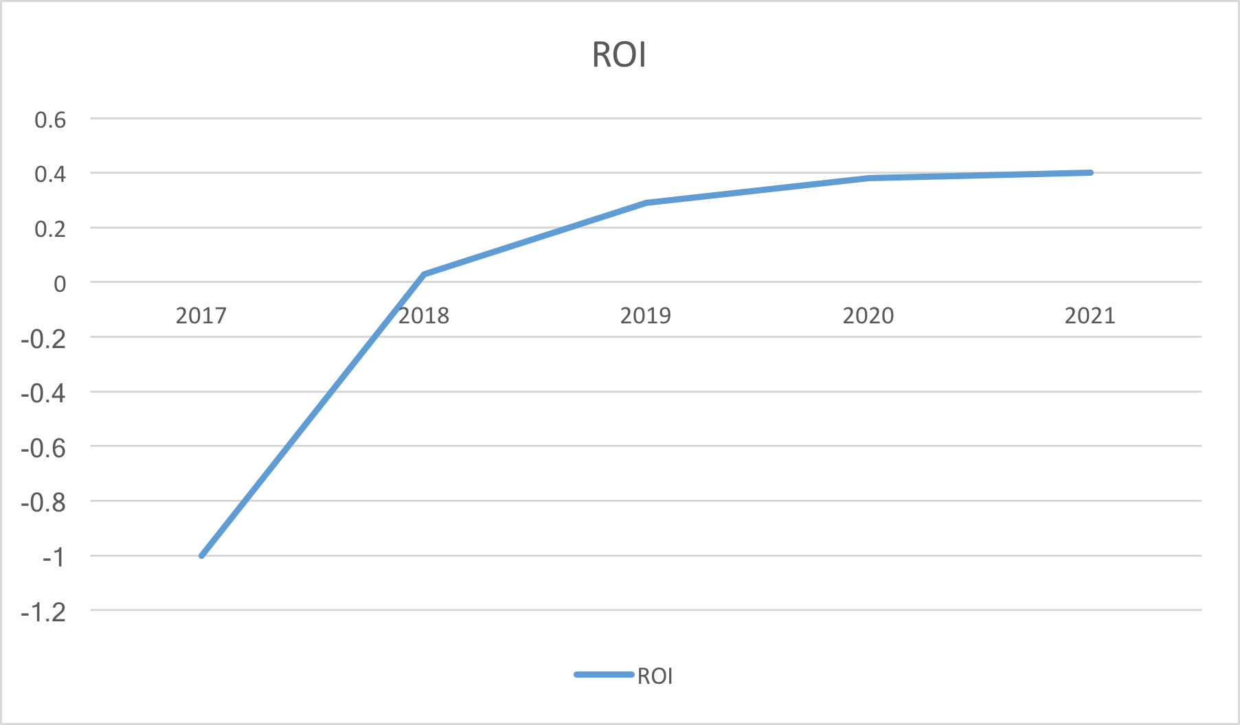
:.: ROI Analysis Graph
62

Slide 67
:.: NDI/NCS Evaluation & Analysis
63
Introduction:
The NDI used in the development of the website are suggested by the client to redesign the existing system without having any interoperability issue.
We are using the Xcode/WebStorm to implement the app layout, UI and buttons. React-Native library is used to incorporate MVC architecture.

Slide 68
:.: NDI/NCS Evaluation & Analysis
64
NDI/NCS Products | Description | Benefit (hours)+ |  | Cumulative e cost |  | Cumulative e benefit
Firebase | DBMS | •High performance •Open source •Easy to manage Json data •High availability |  | Free |  | Open source
React-Native | A framework for building native app | •Easy to learn and use •Open source •Support both iOS and Android platform development |  | Free |  | Open source
AWS | Server | •High performance •Easy to manage •High availability |  | $200/month |  | High performance server

Slide 69
65
:.: Quality Focal Point

Slide 70
:.: Traceability Matrix
66
OCD | Requirement | Use Case
OC-1 Challenge Photos and Videos Post | WC_4601 | EC-6
OC-2 Challenge Complete Competition | WC_4532 WC_4596 WC_4597 WC_4598 | EC-7
OC-3 Challenge Game Suggestion | WC_4535 | EC-10
OC-4 Further 5 Days Daily Challenge Post | WC_4595 | EC-2

Slide 71
:.: Traceability Matrix
67
OCD | Requirement | Use Case
OC-5 View, Approve or Cancel Challenge | WC_4600 | EC-8
OC-6 Challenge Game Pop Screen | WC_4531 | EC-1 EC-2 EC-3 EC-4 EC-5
OC-7 Offline&Online Notification | WC_4534 WC_4546 WC_4599 WC_4600 | TBD
OC-8 Competition Reward | WC_4538 WC_4537 | TBD

Slide 72
:.: Defect identification
68
Review identification type
Peer Review
Client Feedback
Instructors (Prof. & TA) suggestions
ARB
Test identification type
Unit Test
Integration Test
End-to-End

Slide 73
:.: Defect Prevention
69
Strategy | Priority | Level | Description
Win-win negotiation | High | Team, client | Discuss and negotiate with client and obtain feedback from client respect of application functionality.
Version Control | High | Team | Use Github to manage our source codes for codes backup, merging and change tracking.
Jira | High | Team | Track what every team member have done and what he is going to do.
Peer review | Medium | Team | Review team members’ achievements and help each other by promoting feedback and suggestions.
Weekly Team meeting | High | Team | Have team meetings at least twice a week, check process and make sure we are in the same pace.

Slide 74
:.: Current Defect
70
Concern | Proposed Solution
The reward system is not sophisticated. We didn’t think about it in detail and the reason for our inclusion of this functionality is that we wanted to entice users to participant in the challenge feature. | Before starting to implementing, we are ought to gain more information from client and users, and try to prototype the entire reward system.

Slide 75
:.: Technical Debt
71
Description | Mitigation Plan
The current version did not follow the responsive mobile design and it only works for iPhone 7Plus screen resolution. | Incremental test, prototyping and gaining more knowledge about how to implement a responsive mobile app in React Native.

Slide 76
72
:.: Q & A
https://drive.google.com/open?id=1Bg70vQ0_nb4XqvDhcqx0wIrh9gMATkYdaTKLLcRdDk8

